Slide 1
Course Agenda
Go Fundamentals refresh
Structuring our project the right way using modules
Concurrency patterns in go
Creating microservices in go
Creating a multiplayer game server
Containerizing, and deploying our go program
Turning our game server into a kubernetes operator

Slide 2
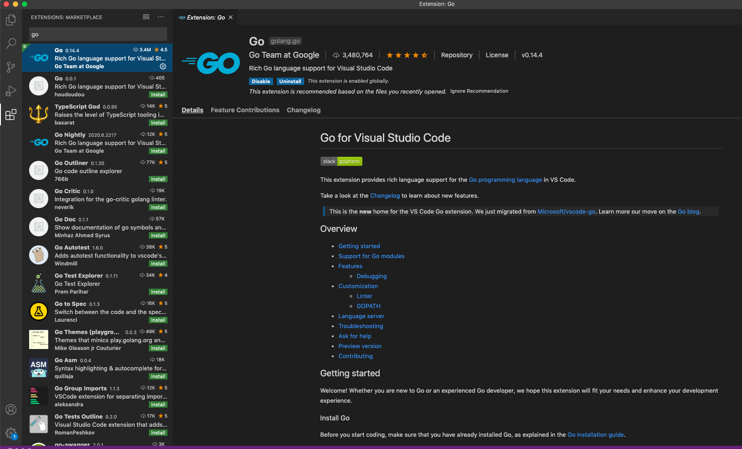
Installing GO on Visual studio code - Step 1
From the left pane choose the extension icon and install the go plugin

Slide 3
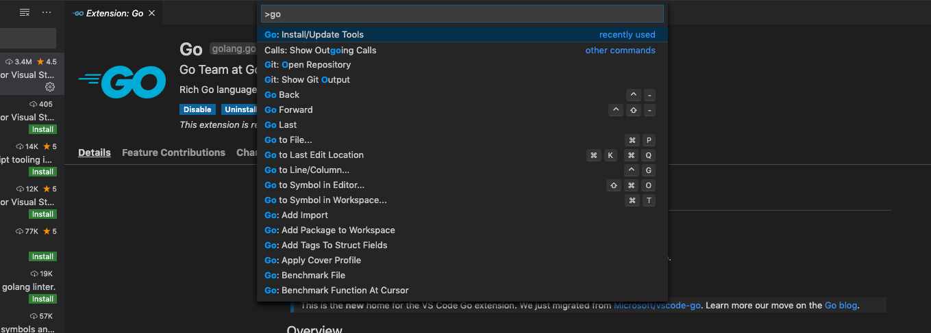
Installing GO on Visual studio code - Step 2
Press ctr+shift+p and enter go in the text box

Slide 4
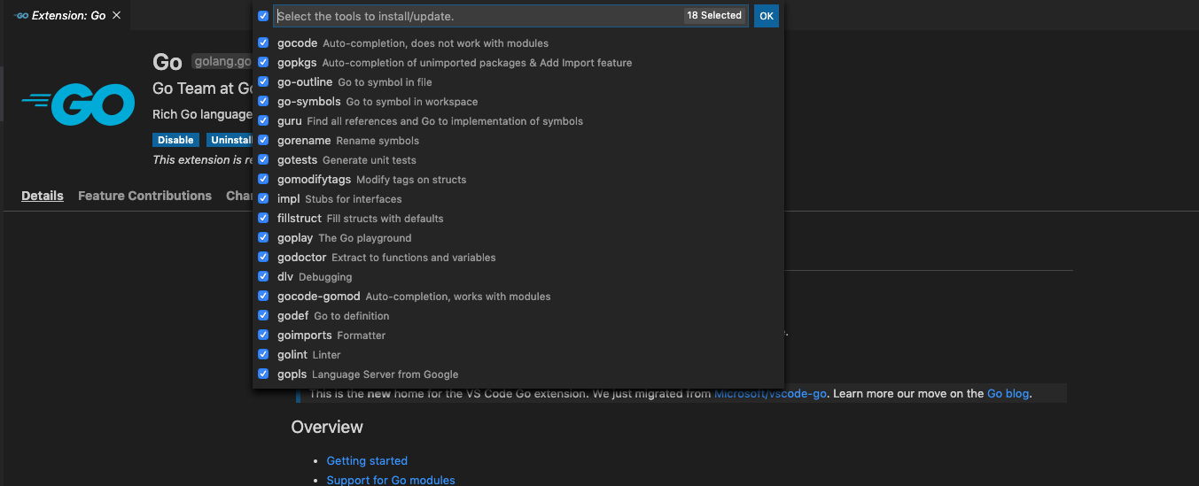
Installing GO on Visual studio code - Step 3
Select all the packages from the list and press enter

Slide 5
GOROOT and GOPATH
When you install Go on your system, it creates a directory /usr/local/go in UNIX or c:/go in Windows. Then it copies all necessary code and binaries needed for Go to function in this directory.
GOROOT env var points there as the path where the go installation lives, alongside the complete standard library, and usually you don’t need to change it
If somehow, your Go installation directory is different than what Go assumes for the location, you can change GOROOT environment variable.
GOPATH is for all other dependent projects not in the standard library, GOPATH/src for the project source, GOPATH/bin is for executables outside the standard go distribution
The default location of $GOPATH is $HOME/go, and it's not usually necessary to set GOPATH explicitly.

Slide 6
Managing a Project in Go - workspaces reminder
The legacy way of organizing a project in go is called a workspace
Prior to go 1.13 go used workspaces in order to gather all the files necessary for a project
Woking in workspace mode means that all of our project related files needs to be in one place referenced by the GOPATH environment variable
When we used to install any dependency packages using go get command, it would save the package files under the $GOPATH/src path
Every dependency must be retrieved using go get prior to utilizing

Slide 7
Managing a Project in Go - workspaces reminder
When you download a package using go get, you are are cloning the master repository at the most recent commit
you can’t install multiple versions of the same dependency package
A Go program couldn’t import a dependency unless it was present inside $GOPATH
Also, the go build command creates binary executable files and package archives inside $GOPATH. Hence, GOPATH used to be a big deal in Go. The downside here is that we need to create all of our projects in one directory, or constantly change our GOPATH.
pkg is where go installs the compiled binaries of third party dependencies, Whenever you install a 3rd party package, a package object package-name.a is created for that package in this directory.

Slide 8
Introducing Go Modules
Go modules gives us a built-in dependency management system
As of go 1.13 modules are the official way to organise our source code as a project
A module is nothing but a directory containing Go packages. These can be distribution packages or executable packages.
A module can also be treated as a package that contains nested packages.
A module is also like a package that you can share with others
Modules allows us to work from any directory, not just GOPATH which gives us the flexibility to relocate our source code anywhere

Slide 9
Introducing Go Modules
Go modules are stored inside $GOPATH/pkg/mod/cache directory (module cache directory). (Seems like we haven’t been able to get rid of $GOPATH at all. But Go has to cache modules somewhere on the system to prevent repeated downloading of the same modules of the same versions).
Modules allows us to install the precise version of a dependency package to avoid breaking changes.
Using modules we are able to import multiple versions of the same dependency package
Like package.json in NPM, each module has a go.mod file that houses the dependencies for our project
If we do -> import "github.com/username/packagename"
In the above package import statement, the package name looks like a URL, because it is. Go can download and install packages located anywhere on the internet.

Slide 10
Creating Go Modules
Unlike Workspaces when using modules we don't need to start under a folder structure (src,pkg and bin directories)
We start from an empty directory and executing the following
$ go mod init github.com/gameserver
*As you can see we passed to init a module identifier
module github.com/gameserver
go 1.14

Slide 11
Retrieving Dependencies
Often we will need to use third party libraries
As we did before with workspaces , we can run the following to fetch a dependent lib
$ go get github.com/gorilla/mux
Please note the indirect comment, this is due to the fact that we are listing the module but not using it.
Once we use the mux router the indirect
comment will go away stating it knows that
we are using the dependency
module github.com/gameserver
go 1.14
require (
github.com/gorilla/mux v1.7.4 // indirect
)

Slide 12
Retrieving Dependencies
We don't see the gorilla/mux on our path like we used to when using workspaces
Go download can cache it for us, (it is located under the $GOPATH/pkg/mod/cache)

Slide 13
Listing Dependencies
Occasionally you will need to know what dependencies your module relies on
If we invoke the $ go list all command we will be able to see all the packages that our module relies on
But if we wish to only get the modules we can execute we can use $ go list -m all
We can also retrieve all the versions a module has by executing
$ go list -m -versions github.com/gorilla/mux

Slide 14
How go Verifies Dependencies
When we retrieve a dependency, go creates another file called go.sum
When a dependency is being retrieved, go creates a unique hash and assigns it to the dependency
The hash is unique based on the source code of the specific version that was retrieved
The main reason for this is to make sure that the dependent module was not tampered with in any way
To validate that the modules an app contain has not been modified we can issue the following command $ go mod verify

Slide 15
Cleaning unused Dependencies
Sometimes we no longer need a dependency, and wish to remove it so that our app will be as lean as possible
go has no way of knowing if we stopped using a dependency unless it rebuilds the entire dependency graph, which is a heavy operation
$ go mod tidy will do that for us

Slide 16
Semantic Versioning With Modules
Semantic versioning is applied to a go system in a very strict way
An example for a version number -> v1.6.8
The v letter is a must and it indicates that we are talking about a version
The first digit “1” after the v indicates a major revision – when moving to a higher number it does not guarantee backward compatibility, but any version starting with that same value should be backwards compatible
The second digit after the dot “6” indicates minor revision, telling us is that the module has new features but backward compatibility remains intact (or should)
The last digit after the last dot “8” is the patch, it promises not to introduce new features but only to fix bugs

Slide 17
Versioning rules for go modules
All versions prior to v1 do not have to preserve backward compatibility
Backward compatibility should be preserved within major versions
Each Major version should pass a version identifier with a unique path with a suffix that entails the version for example:
import github.com/gorilla/mux/v2
The reason for this is to allow us to upgrade the version in a gradually measured way

Slide 18
Organizing major module versions
Usually we will use the “main” or “master” branch for the main v1 of our module
Every additional major revision can be added to a different branch
Need to remember to add a tag to this newly created branch to mark the new version
Also we should update the module name with the suffix for it’s new version for example github.com/example/v3
We can use more than one major revision of a module in our project provided that we’ve added an alias in the import section
module github.com/gameserver/v3
go 1.14
import (
"rsc.io/quote"
quotev3 "rsc.io/quote/v3"
)

Slide 19
Importing unversioned modules
What happens when we need to use a module that does not have any major.minor.patch semver?
The short answer is that the go tooling will fix it in a way to allow us to import much as we did before with semver
The long answer is that the go tooling will create a prerelease semver based on the latest commit hash and timestamp – for example, if we import golang.org/x/tools we will have in our go.mod file:
golang.org/x/tools v0.0.0-20200622192924-4fd1c64487bf

Slide 20
Requesting a Specific Module
The module system allows us to request a specific module by using the @ sign for example $ go get github.com/gorilla/mux@v1.6.1
We could also ask for a version with the following :
Version prefix: just use for example @v1 and it will fetch the latest version with this major revision
@latest : will fetch the latest version from the repo
Specific commit : for example @c55772
@master: will fetch the head of master, the latest commit
Comparison operator: @>=1.5.0 , we are asking for a version greater or equal to 1.5.0,always remember that the closest match wins

Slide 21
Go mod additional commands
$ go mod why github.com/rsc.io/quote builds a dependency tree in order to show us the modules that use it and all the modules required by it
$ go mod graph will show you a tree of all the modules in your app and their dependent modules
If you need to point to the local version of a dependency in Go rather than the one over the web, use the edit option with the replace argument
$ go mod edit -replace github.com/rsc.io/quote=/Users/motiso/Projects/quote

Slide 22
Go mod additional commands
$ go mod download github.com/rsc.io/quote is used to download the module into the build cache so it will be available for later builds
The `go mod vendor` command will create a vendor folder and will hold all the dependencies in that location; it might be useful for organizations that do not want a production build server to retrieve the dependency from the internet
To use the vendor directory you need to use $ go run -mod vendor . Please note that all dependencies must be in the vendor directory as go will not mix it with what is in the cache

Slide 23
Go Project Structure
As your project grows, keep in mind that it'll be important to make sure your code is well structured; otherwise you'll end up with messy code with lots of hidden dependencies and global state
The following is just a recommendation for a basic layout for Go application projects based on a set of common historical and emerging project layout patterns in the Go ecosystem
GO Directories
/cmd - the main application go file should be placed in this directory, if you have other executables each should be placed in a sub directory (for example /cmd/myutil)
/internal - Private application and library code; this is the code you don't want others importing in their applications or libraries
/pkg - Library code that's ok to use by external applications (e.g., /pkg/mypubliclib). Other projects will import these libraries expecting them to work, so think twice before you put something here :-)
/vendor - Application dependencies (managed manually or by your favorite dependency management tool like the new built-in Go Modules feature)
/web - Web application specific components: static web assets, server side templates and SPAs
And more … https://github.com/golang-standards/project-layout
Notes:
/cmd - (The directory name for each application should match the name of the executable you want to have)

Slide 24
Concurrency Patterns in Go

Slide 25
Concurrency Patterns in Go
Lexical confinement
Use lexical scope to manage access to data and concurrency primitives
Limit how multiple concurrent processes can interact with the data
Helps ensure correct approach to concurrency (but likely limited to simplest use cases)
For example, using directionality on channels to only expose read or write access in a controlled manner

Slide 26
Concurrency Patterns in Go
Preventing goroutine leaks
Go is very efficient at multiplexing goroutines onto available threads
As a result, goroutines are cheap and easy to create
However, do cost resources and they are not garbage collected by runtime
Common to use a “done” channel to signify termination and defer close for channels created in goroutines

Slide 27
Concurrency Patterns in Go
Error handling
If errors encountered in concurrent process, can send info as part of a struct
Rather than goroutine trying to print or handle error with limited context…
Can pass error to parts of the code that are in better position to interrogate and manage/handle

Slide 28
Concurrency Patterns in Go
Pipelines
Using concurrency primitives, data can be passed (using channels) through a series of “phases”
At each “phase”, transformation logic or processing can be applied
Output from the current “phase” gets piped into the next phase for additional processing
Enables engineers to build a series of processing that combines sets of utility steps in different ways based on requirements

Slide 29
Concurrency Patterns - Demo

Slide 30


The Game Server App
Game frontend
Game backend
Users Service
Game Service

Slide 31
The Game Server API
GetGameInfo
Login/Register
Web Socket
GetUsersList
Clients
Game Server Api
StartNewGame
JoinExistingGame
SendGameMessage

Slide 32
├── Dockerfile
├── README.md
├── cmd
│ ├── keys
│ │ ├── app.rsa
│ │ └── app.rsa.pub
│ └── main.go
├── deployments
│ ├── config.yaml
│ ├── database.yaml
│ └── gameserver.yaml
├── go.mod
├── go.sum
└── internal
├── auth
│ ├── auth.go
│ └── token.go
├── games
│ ├── game.go
│ ├── gamemanager.go
│ ├── gamemessages.go
│ ├── gamesession.go
│ ├── gamesutils.go
│ ├── player.go
│ ├── service
│ │ └── game.service.go
│ └── utils
├── routes
│ └── routes.go
├── users
│ ├── service
│ │ └── user.service.go
│ └── user.go
└── utils
├── db.go
└── exception.go
Game Server Components
Authentication Components
Game service Components
Routing
User Service Components
App utils (database,etc…)

Slide 33
Building Web Services With GO
Web services are a special type of program exposing an API for consumers or clients
Web services enable a separation of concerns between different layers of our application
While web services can provide data in a number of different formats, XML and JSON are the most common
User Management Api
Client facing API
Data Management API
Payment Processing API

Slide 34
Rest - REpresentational State Transfer
Restful services go hand-in-hand with http for all requests and responses
Restful APIs are intended to be stateless – i.e., the service doesn’t have to remember anything about the caller
Restful services expose their api using uri’s called endpoints
Each endpoint uniquely maps to a resource, enabling retrieval or modification of its state, for example :
example.com/authors - return all the Authors
example.com/author/1 - return a specific author

Slide 35
Rest - Requests
The request http method dictates the action that we wish to perform on the resource exposed by the api – most common are GET, PUT, POST and DELETE
The request body is optional and most commonly contains json formatted data
The requests can also include metadata in the HTTP headers, which can be useful for things like sending authentication tokens, etc…

Slide 36
Rest Responses
Every http response contains a status code – the status code is used by the restful web service to indicate whether the request was successfully processed
Response can also contain a Body with data containing the requested resource
Response can also contain headers with metadata for example, the content length of the data, cookies, etc...
2xx: Success | Indicates that the client’s request was accepted successfully.
3xx: Redirection | Indicates that the client must take some additional action in order to complete their request.
4xx: Client Error | This category of error status codes points the finger at clients (bad message format, etc)
5xx: Server Error | The server takes responsibility for these error status codes.
Notes:
https://restfulapi.net/http-status-codes/
200 , simply means that the request succeeded ,
201 , means that a new resource was created
202 , means that the request was accepted but no action has happened yet on the server
300 indicated a redirection to a different place , it is useful for example when a website has moved
400 means bad request , the request was not formatted correctly for example
401 means that the client is unauthorized
403 , means forbidden the client is authenticated but do not have access to the resource
404 used when a resource was not found
500 means that something went wrong when processing the request on the server

Slide 37
Handling Http Requests
The go standard library provides us the net/http package for all kind of http operations
When using the net/http package, there are two main ways for handling http requests:
Implementing the handler interface and passing it to the http.Handle function – the handler interface implements the handle function to match a specific pattern
Using the http.handleFunc and passing it a function that is implemented for a specific request pattern

Slide 38
Handling Http Requests - Using Handler example
package main
import "net/http"
//MyHandler type
type MyHandler struct{}
func (handler MyHandler) ServeHTTP(rs http.ResponseWriter, rq *http.Request) {
rs.Write([]byte("Hello world"))
}
func main() {
var myhandler MyHandler
http.Handle("/books", myhandler)
http.ListenAndServe(":5000", nil)
}

Slide 39
Handling Http Requests - Using Handlerfunc
package main
import "net/http"
func main() {
http.HandleFunc("/books", func(rs http.ResponseWriter, rq *http.Request) {
rs.Write([]byte("Hello world from handler func"))
})
http.ListenAndServe(":5000", nil)
}

Slide 40
Http ServeMux
A ServeMux is just an http handler that takes a url and matches its pattern to registered handlers
You have probably noticed that we’ve used http.ListenAndServe(":5000", nil) which indicates that we want to use the default http ServeMux (we can also use our own)
We could also use the https version http.ListenAndServeTLS(string,certfile,keyfile,string,handler)
It will always try to find the best match for the url from the list of registered patterns for example:
/books/go
/books/golang
/books/golang/1
/books/golang/

Slide 41
Module01 - Exercise

Slide 42
Working With Json
The primary data format that is being used by web apps to communicate with restful services is probably JSON
Go provides us an easy way for working with the JSON data format by using the encoding/json standard library
There are two main ways for working with json
Using the Marshal and Unmarshal functions of the json package
Using the Encoding and Decoding functions of the json package

Slide 43
Json.Marshall
package main
import (
"encoding/json"
"fmt"
"log"
)
// Student type
type Student struct {
fullName string
Name string
Age int `json:"age"`
City string `json:"city"`
}
func main() {
student := Student{
Name: "Dave",
Age: 37,
City: "Denver",
}
d, err := json.Marshal(&student)
if err != nil {
log.Fatalf("json.Marshal failed with '%s'\n", err)
}
fmt.Printf("Student in compact JSON: %s\n", string(d))
d, err = json.MarshalIndent(student, "", " ")
if err != nil {
log.Fatalf("json.MarshalIndent failed with '%s'\n", err)
}
fmt.Printf("student in pretty-printed JSON:\n%s\n", string(d))
}
Json Marshal takes interface{} as a parameter which means it can process any type
Marshaller uses reflection to understand the real type
When marshalling structs only the exported types will be marshalled
You can use string tags to require different names and options to marshall with
json.MarshallIndent allows for pretty-printing of nested structures

Slide 44
Json Unmarshal
package main
import (
"encoding/json"
"fmt"
"log"
)
//Student type
type Student struct {
Name *string `json:"name"`
Age int `json:"age"`
City string
Major string
}
var jsonStr = `{
"name": "Dave",
"age": 37,
"city": "denver"
}`
func main() {
var student Student
err := json.Unmarshal([]byte(jsonStr), &student)
if err != nil {
log.Fatalf("json.Unmarshal failed with '%s'\n", err)
}
fmt.Printf("Student struct parsed from JSON: %#v\n", student)
fmt.Printf("Name: %#v\n", *student.Name)
}
When unmarshalling, we have to pass a pointer to a struct; otherwise, we will get an error
Notice that although we did not provide accurate mapping in the City element the JSON decoder is smart enough to unmarshall the city field
Field Name shows that the JSON decoder can also automatically decode into a pointer to a value

Slide 45
Json Encode And Decode
package main
import (
"encoding/json"
"fmt"
"log"
"os"
)
//Book type
type Book struct {
Title string `json:"title"`
Subtitle string `json:"subtitle"`
Author string `json:"author"`
Published string `json:"published"`
}
func main() {
file, err := os.Open("../books.json")
defer file.Close()
if err != nil {
log.Fatalf("an error occured openinng the file")
}
var books []Book
err = json.NewDecoder(file).Decode(&books)
if err != nil {
log.Fatalf("couldn't decode file into json")
}
for _, book := range books {
fmt.Println(book.Title, " ", book.Author)
}
bookNewfile, err := os.Create("booksnew.json")
defer file.Close()
if err != nil {
log.Fatalf("couldnt create file")
}
json.NewEncoder(bookNewfile).Encode(books)
}
We can decode and encode JSON data from a file on disk or network connection, etc; actually, we can decode from any io.Reader

Slide 46
Custom Json Marshaling and UnMarshaling
Sometimes we need to control the format of the json data when marshaling and unmarshaling
For example, what if we need to change the way time is formatted?
We can control the marshaling and unmarshaling by implementing the json.Marshaler interface for the requested type
type customTime time.Time
const customFormatUnmarshal = `"2006-01-02T15:04:05Z07:00"`
const customFormatMarshal = `"Monday, 02-Jan-06 15:04:05 MST"`
//Book type
type Book struct {
Title string `json:"title"`
Subtitle string `json:"subtitle"`
Author string `json:"author"`
Published customTime `json:"published"`
}
func (ct customTime) MarshalJSON() ([]byte, error) {
t := time.Time(ct)
s := t.Format(customFormatMarshal)
return []byte(s), nil
}
func (ct *customTime) UnmarshalJSON(d []byte) error {
t, err := time.Parse(customFormatUnmarshal, string(d))
if err != nil {
return err
}
*ct = customTime(t)
return nil
}

Slide 47
Controlling JSON serialization
We can hide specific fields from json structs by using a first lowercase letter in the field or tagging the json field with the “-” letter; for example:
We can also omit fields when they are empty by tagging them as in the following example:
type Book struct {
Title string `json:"title"`
Subtitle string `json:"subtitle"`
Author string `json:"author"`
Published string `json:"-"`
isbn string
}
type Book struct {
Title string `json:"title"`
Subtitle string `json:"subtitle,omitempty"`
Author string `json:"author"`
Published string `json:"-"`
isbn string
}

Slide 48
So, what method should we use for serializing json?
The Simple rule is as follows:
Use json.Decoder if your data is coming from an io.Reader stream, or you need to decode multiple values from a stream of data
Use json.Unmarshal if you already have the JSON data in memory

Slide 49
Module02 - Exercise

Slide 50
Inroducing Http Request object
All http requests have a method property usually describing the restful operation context
The Headers is a map of strings that gives us access to the headers for the requests
And the Body which is of type io.ReadCloser is the actual data received which could be JSON formatted data
Method
Headers
Body

Slide 51
Handling Http Requests
The ServeMux just matches a url pattern to a handler
We could have one handler handling all the CRUD operations for a specific entity
When the client sends a request, we are responsible to handle it based on the parameters sent
Please note that we need to extract the parameters passed in the url to be able to respond correctly; for example, for books/123 we will have to extract the “123” as the id of the book, and combine it with the request.HttpMethod to take the right action

Slide 52
MiddleWare
Occasionally we need to add code that is intended for every incoming request
This code is not necessarily tied to the logic in our application but serves as more general code that is intended to reduce duplication
For example, check for user authentication, add access control, add logging information for the requests, load user profile information, etc…
In Middleware, we can execute functionality before or after the http handler gets called

Slide 53
Examining the http.HandlerFunc
The http.HandlerFunc is a function type :
type HandlerFunc func(ResponseWriter, *Request)
it implements the interface HttpHandler
func (f HandlerFunc) ServeHTTP(w ResponseWriter, r *Request) {
f(w, r) }
We can use this type as an http.HttpHandler adapter which will allow us to use functions as handlers by having those functions be of type HttpHandler
http.Handle("/books/", http.HandlerFunc(handleBook))
This happens due to the type conversion resident in the go language – we do a type conversion to the handleBook that has the same signature of HandlerFunc

Slide 54
Middleware example
func myMiddleware(handler http.Handler) http.Handler {
return http.HandlerFunc(func(rs http.ResponseWriter,
rq *http.Request) {
fmt.Println("called before")
handler.ServeHTTP(rs, rq)
fmt.Println("called after")
})
}
func main() {
booksHandler := http.HandlerFunc(handleBooks)
http.Handle("/books", myMiddleware(booksHandler))
http.HandleFunc("/books/", handleBook)
if err := http.ListenAndServe(":5000", nil); err != nil {
log.Fatalf(err.Error())
}
}
In the following example, we have a myMiddleware function that takes httphandler and returns httphandler (it basically wraps the handler passed in)
The returned function is converted to a handler (happens automatically by using the http.HandleFunc)
Inside the function implementation we call the ServeHttp method which is the one invoking the middleware chain
Remember that the implementation of the http.HandlerFunc calls the actual function
func (f HandlerFunc) ServeHTTP(w ResponseWriter, r *Request) {
f(w, r) }

Slide 55
Module03 - Exercise

Slide 56
Using the Default ServeMux, not the easiest way...
As you saw before, we pass to the http.ListenAndServe nil as a third parameter which is the default ServeMux
The default ServeMux leaves us the responsibility of parsing the url parameters, and checking the Request method in the handlers
We need to find a better way to save us the boilerplate code for each new service

Slide 57
Simplify routing with the gorilla/mux package
It implements the http.Handler interface so it is compatible with the standard http.ServeMux.
func main() {
r := mux.NewRouter()
r.HandleFunc("/", HomeHandler)
r.HandleFunc("/products", ProductsHandler)
r.HandleFunc("/articles", ArticlesHandler)
http.Handle("/", r)
}
Paths can have variables. They are defined using the format {name} or {name:pattern}. If a regular expression pattern is not defined, the matched variable will be anything until the next slash. For example:
URL hosts, paths and query values can have variables with an optional regular expression.
r := mux.NewRouter()
r.HandleFunc("/products/{key}", ProductHandler)
r.HandleFunc("/articles/{category}/", ArticlesCategoryHandler)
r.HandleFunc("/articles/{category}/{id:[0-9]+}", ArticleHandler)
The names are used to create a map of route variables which can be retrieved calling mux.Vars():
func ArticlesCategoryHandler(w http.ResponseWriter, r *http.Request) {
vars := mux.Vars(r)
w.WriteHeader(http.StatusOK)
fmt.Fprintf(w, "Category: %v\n", vars["category"])
}

Slide 58
Simplify routing with the gorilla/mux package
Middleware can be easily added with a .Use() method similar to how the node express framework works with middleware
r := mux.NewRouter()
r.HandleFunc("/", handler)
amw := authenticationMiddleware{}
amw.Populate()
r.Use(amw.Middleware)
There are more features and options at: https://github.com/gorilla/mux

Slide 59
Module04 - Exercise

Slide 60
Reading Configuration files And Environment variables
It is considered best practice to store app configuration data and sensitive data outside of the application
Sensitive data like DB connection credentials usually will be environment specific and will be set in the environment using env vars or files
Other configuration data comes in handy when we wish to affect the behaviour of our app based, for example, on the environment it is running on like development/production
Also some apps should act in a dynamic way and change based on configuration, like for example nginx.conf file
It is required to keep the app configuration outside of the code, otherwise we will not be able to change the app behaviour after it is built

Slide 61
Go support libraries for configuration - 1. godotenv
The easiest way to load the .env file is using godotenv package.
godotenv provides a Load method to load the env files.
// Load the .env file in the current directory
godotenv.Load()
// or
godotenv.Load(".env")
The problem with godotenv is that it does not load the
environment variables automatically if they are not found in the env file
func goDotEnvVariable(key string) string {
// load .env file
err := godotenv.Load(".env")
if err != nil {
log.Fatalf("Error loading .env file")
}
return os.Getenv(key)
}

Slide 62
Go support libraries for configuration - 2. Viper
From viper :
“Viper is a complete configuration solution for Go applications including 12-Factor apps. It is designed to work within an application, and can handle all types of configuration needs and formats. It supports:
setting defaults
reading from JSON, TOML, YAML, HCL, envfile and Java properties config files
live watching and re-reading of config files (optional)
reading from environment variables
reading from remote config systems (etcd or Consul), and watching changes
reading from command line flags
reading from buffer
setting explicit values
Viper can be thought of as a registry for all of your applications configuration needs.”

Slide 63
Reading Configuration with viper
package main
import (
"fmt"
"github.com/spf13/viper"
corev1 "k8s.io/api/core/v1"
)
func main() {
// Set the file name of the configurations file
viper.SetConfigName("config")
// Set the path to look for the configurations file
viper.AddConfigPath(".")
// Enable VIPER to read Environment Variables
viper.AutomaticEnv()
viper.SetConfigType("yml")
var configuration corev1.Secret
if err := viper.ReadInConfig(); err != nil {
fmt.Printf("Error reading config file, %s", err)
}
// Set undefined variables
viper.SetDefault("database.dbname", "test_db")
err := viper.Unmarshal(&configuration)
if err != nil {
fmt.Printf("Unable to decode into struct, %v", err)
}
// Reading variables using the model
fmt.Println("Reading variables using the model..")
fmt.Println("username are\t", configuration.StringData["username"])
fmt.Println("password is\t\t", configuration.StringData["password"])
// Reading variables without using the model
fmt.Println("\nReading variables without using the model..")
fmt.Println("Database is\t", viper.GetString("database.dbname"))
fmt.Println("EXAMPLE_PATH is\t", viper.GetString("EXAMPLE_PATH"))
fmt.Println("EXAMPLE_VAR is\t", viper.GetString("EXAMPLE_VAR"))
}
viper.SetConfigName("config") → Provides the configuration file name.
viper.SetConfigPath(".") → Provides the path in which viper needs to search for the configuration file.
viper.AutomaticEnv() → Tells viper to look at the Environment Variables.
viper.ReadInConfig() → Reads all the configuration variables.
viper.Get("variable_name") → Returns the value of the "variable name" variable from environment configurations first and, if it is not available, it reads from the configuration file.
viper.SetDefault("database.dbname", "test_db") → Sets a default value

Slide 64
Persisting data into a database
The go standard library provides us the sql package for interacting with a database
The open function enables us to open a connection to a database, this function is passed a driver for the database and the datasource, which is the connection string to the db
db, err := sql.Open("mysql", "username:password@tcp(127.0.0.1:3306)/mydb")
The function returns a DB type object which manages the connections to the database within a connection pool
The DB will open and close connections on demand and will do it in a thread safe way
Please note that we also have the same method with the same signature except that it returns a single connection “Conn type”

Slide 65
Connecting to a Database
Let’s start by running a db using a docker image
$ docker run -p 3306:3306 -p 33060:33060 --name mysqldb -v ~/mysql:/var/lib/mysql -e MYSQL_ROOT_PASSWORD=pass -d mysq
Please note that beside the sql import package we also need to import the relevant database driver
On the following example we use mysql driver
Also note that we are using the “_” to allow the driver to be imported although there is no direct use of it from our code
See https://golang.org/s/sqldrivers for a list of drivers.
package main
import (
"database/sql"
"log"
_ "github.com/go-sql-driver/mysql"
)
func main() {
db, err := sql.Open("mysql", "root:pass@(127.0.0.1)/game_db")
if err != nil {
log.Fatalf("couldn't open database connection")
}
}

Slide 66
Query the database
The sql package exports the Query function
func (db *DB) Query(query string, args ...interface{}) (*Rows, error)
It takes a string for the sql and a bunch of parameters that can optionally be passed to the query (for parameterized queries)
It returns a Rows type which allows us to iterate by using it’s next method
During iteration on the rows we need to call scan in order to get the data into our go types

Slide 67
Query database example
package main
import (
"database/sql"
"fmt"
"log"
_ "github.com/go-sql-driver/mysql"
)
type User struct {
id int
first_name string
last_name string
email string
password string
}
var users []User = make([]User, 0)
func main() {
db, err := sql.Open("mysql", "root:pass@(127.0.0.1)/game_db")
if err != nil {
log.Fatalf("couldnt open database connection")
}
rows, err := db.Query("select id,first_name , last_name, email , password from users")
for rows.Next() {
var user User
rows.Scan(&user.id, &user.first_name, &user.last_name, &user.email, &user.password)
users = append(users, user)
}
fmt.Println(users)
}
Please note that we didn’t use the “*”
In the select statement , it is important to match the fields to the number of values returned from the query in the order we get them

Slide 68
Query With Parameters
package main
import (
"database/sql"
"fmt"
"log"
_ "github.com/go-sql-driver/mysql"
)
type User struct {
id int
first_name string
last_name string
email string
password string
}
func main() {
db, err := sql.Open("mysql", "root:pass@(127.0.0.1)/game_db")
if err != nil {
log.Fatalf("couldnt open database connection")
}
name := "dave"
row := db.QueryRow("select id,first_name , last_name, email , password from users where first_name =?", name)
var user User
err = row.Scan(&user.id, &user.first_name, &user.last_name, &user.email, &user.password)
if err == sql.ErrNoRows {
log.Fatalf("couldnt find what we are looking for")
} else if err != nil {
log.Fatalf("couldnt find what we are looking for", err.Error())
}
fmt.Println(user)
}
We can also use QueryRow to fetch a single row; if the result of the query returns multiple rows, only the first one will be returned

Slide 69
Executing Database Commands
DB.Exec enables us to execute commands like insert update and delete ,on the database func (db *DB) Exec(query string, args ...interface{}) (Result, error)
This function returns a Result interface that has two methods
LastInsertId(...) that is used to indicate the last inserted row id
RowsAffected(...) that returns the number of rows that were changed as a result for example on an update, insert or delete operation
type Result interface {
// LastInsertId returns the integer generated by the database
// in response to a command. Typically this will be from an
// "auto increment" column when inserting a new row. Not all
// databases support this feature, and the syntax of such
// statements varies.
LastInsertId() (int64, error)
// RowsAffected returns the number of rows affected by an
// update, insert, or delete. Not every database or database
// driver may support this.
RowsAffected() (int64, error)
}

Slide 70
sql.Exec example
package main
import (
"database/sql"
"fmt"
"log"
_ "github.com/go-sql-driver/mysql"
)
type User struct {
id int
first_name string
last_name string
email string
password string
}
var users []User = make([]User, 0)
func main() {
db, err := sql.Open("mysql", "root:pass@(127.0.0.1)/game_db")
if err != nil {
log.Fatalf("couldnt open database connection")
}
id := 1
result, err := db.Exec("update users set last_name =? where id = ?", "axel", id)
if num, err := result.RowsAffected(); err != nil {
log.Fatalf("couldnt update database ", err.Error())
} else {
fmt.Println("numner of rows affected is ", num)
}
result, err = db.Exec("insert into users(first_name,last_name,email,password)values(?,?,?,?)", "jon", "smith", "son@gmail.com", "passpaass")
if err != nil {
log.Fatalf("couldnt insert into database ", err.Error())
} else {
if id, e := result.LastInsertId(); e != nil {
fmt.Println("no rows affected")
} else {
fmt.Println("new row is ", id)
}
}
}

Slide 71
Database Connection management
The DB type knows how to handle multiple connections to the database by opening and closing, and reusing connections based on the traffic
The DB manages a pool of connections
We can configure the number of connections in the pool for optimizing the number of concurrent connections from clients
db.SetConnMaxLifetime() - maximum amount of time the connection will be open 0 value means connections will never be closed
db.SetMaxIdleConns() - determines how many connection stay in the pool without being used
db.SetMaxOpenConns() - the number of open connections at any given time
when we exceed the number of connections the new request is going to block, and the client will get a connection timeout … how can we handle this?

Slide 72
Module05 - Exercise

Slide 73
Accessing Database with context
The prefered way is to use contexts for running operations against the database
context allows us to control operations that might take too long to complete,
So one way we can handle it is create a context object with a timeout that once exceeded we can can free the connection for other clients to use
In the db.Sql package there are equivalent functions to those we saw (query,exec,etc..) that take context as a first parameter

Slide 74
Accessing Database with context - sample
package main
import (
"context"
"database/sql"
"fmt"
"log"
"os"
"time"
_ "github.com/go-sql-driver/mysql"
)
type User struct {
id int
first_name string
last_name string
email string
password string
}
var users []User = make([]User, 0)
func main() {
db, err := sql.Open("mysql", "root:pass@(127.0.0.1)/game_db")
defer db.Close()
if err != nil {
log.Fatalf("couldnt open database connection")
}
ctx := context.Background()
ctx,cancel := context.WithTimeout(ctx,time.Second * 15)
defer cancel()
rows, err := db.QueryContext(ctx,"select id,first_name , last_name, email , password from users")
defer rows.Close()
for rows.Next() {
var user User
rows.Scan(&user.id, &user.first_name, &user.last_name, &user.email, &user.password)
users = append(users, user)
}
fmt.Println(users)
}
In order to use context, we need to start by creating one – for that we can use the context.Background function followed by a call to context.WithTimeout to get a context that is bound to a time
Please note that you have to remember to call defer cancel() so that the context will be closed and there will be no memory leak

Slide 75
Running operations with context
So what is a Context ? from the formal definition in the docs :
“A Context carries deadlines, cancellation signals, and other request-scoped values across API boundaries and goroutines”
context.Context is a simple object that is meant to be transferred between a caller to a receiver, in order to allow more control on the requested operation
Most use context with downstream operations, like making an HTTP call, or fetching data from a database, or while performing async operations with go-routines
Another highly useful feature of context is it’s ability to cancel, or halt an operation mid-way
For example a caller can decide to cancel a long running Http request and the receiver is responsible to abandon the operation once cancelled
A context can also be set with a predefined time out that the receiver that gets the context should check periodically to decide whether to abandon the operation or not

Slide 76
Creating a Context
When calling Api’s that require a context, if you don’t have one you can create one easily by calling context.Background()
context.Background() serves as the root of all contexts which will be derived from it
This empty context has no functionality at all and we can add functionality by deriving a new context from it using the following values
A derived context can be created in 4 ways
Passing request-scoped values - using WithValue() function of context package
With cancellation signals - using WithCancel() function of context package
With deadlines - using WithDeadine() function of context package
With timeouts - using WithTimeout() function of context package
It’s critically important that any cancel function returned from a With function is executed before that function returns. This is why the idiom is to use the defer keyword right after the With call, as you see on line 26. Not doing this will cause memory leaks in your program.

Slide 77
When to use contexts
To pass data to downstream. Eg. a HTTP request creates a request_id, request_user which needs to be passed around to all downstream functions for distributed tracing
When you want to halt the operation midway – an HTTP request should be stopped because the client disconnected
When you want to halt the operation within a specified time from start i.e with timeout – Eg- a HTTP request should be completed in 2 sec or else should be aborted
When you want to halt an operation before a certain time – Eg. a cron is running that needs to be aborted in 5 mins if not completed.

Slide 78
Using Context to for canceling http request
The following example issues an http request; if the request takes more then 5 seconds to complete it is being canceled
package main
import (
"context"
"fmt"
"net/http"
"time"
)
func main() {
ctx, cancel := context.WithCancel(context.Background())
go func() {
fmt.Println("before request")
client := &http.Client{Timeout: 30 * time.Second}
req, err := http.NewRequest("GET", "http://127.0.0.1:9191", nil)
if err != nil {
panic(err)
}
req = req.WithContext(ctx)
_, err = client.Do(req)
if err != nil {
panic(err)
}
fmt.Println("will not reach here")
}()
time.Sleep(5 * time.Second)
cancel()
fmt.Println("finished")
}
client.go
package main
import (
"fmt"
"log"
"net/http"
"time"
)
func handler(w http.ResponseWriter, r *http.Request) {
fmt.Println("before sleep")
time.Sleep(10 * time.Second)
fmt.Println("after sleep")
fmt.Fprintf(w, "Hi")
}
func main() {
http.HandleFunc("/", handler)
log.Fatal(http.ListenAndServe(":9191", nil))
}
Server.go

Slide 79
Using Context With Timeout
package main
import (
"context"
"fmt"
"time"
)
func simulateLongOperation(ctx context.Context) (time.Time,error) {
select {
case <-ctx.Done():
return time.Time{}, ctx.Err()
case t := <-time.After(time.Millisecond * 100 ):
return t, nil
}
return time.Time{},nil
}
func main() {
ctx, _ := context.WithTimeout(context.Background(), time.Millisecond*20)
t,err := simulateLongOperation(ctx)
if err != nil{
fmt.Println("Called simulateLongOperation() with 20ms ", err.Error())
}else{
fmt.Println("operation was fiinished after 100 ms at",t)
}
}
We can use context to give an operation a deadline so that after the specified amount of time the operation will be aborted
To do this we listen for incoming messages on the chanel that is returned from ctx.Done()
“The returned context's Done channel is closed when the deadline expires, when the returned cancel function is called, or when the parent context's Done channel is closed, whichever happens first”

Slide 80
Passing values with context
package main
import (
"context"
"net/http"
"github.com/google/uuid"
)
func main() {
helloWorldHandler := http.HandlerFunc(HelloWorld)
http.Handle("/welcome", inejctMsgID(helloWorldHandler))
http.ListenAndServe(":8080", nil)
}
//HelloWorld hellow world handler
func HelloWorld(w http.ResponseWriter, r *http.Request) {
msgID := ""
if m := r.Context().Value("msgId"); m != nil {
if value, ok := m.(string); ok {
msgID = value
}
}
w.Header().Add("msgId", msgID)
w.Write([]byte("Hello, world"))
}
func inejctMsgID(next http.Handler) http.Handler {
return http.HandlerFunc(func(w http.ResponseWriter, r *http.Request) {
msgID := uuid.New().String()
ctx := context.WithValue(r.Context(), "msgId", msgID)
req := r.WithContext(ctx)
next.ServeHTTP(w, req)
})
}
Sometimes you need to pass data to downstream. For example : HTTP request that creates a msgId which needs to be passed around to all downstream functions.

Slide 81
Module06 - Exercise

Slide 82
Testing http service
Go provide us out of the box mock for http in httptest package to help us test our http server
func TestBooksIndex(t *testing.T) {
rec := httptest.NewRecorder()
req, _ := http.NewRequest("GET", "/books", nil)
env := Env{db: &mockDB{}}
http.HandlerFunc(env.booksIndex).ServeHTTP(rec, req)
expected := "978-1503261969, Emma, Jayne Austen, £9.44\n978-1505255607, The Time Machine, H. G. Wells, £5.99\n"
if expected != rec.Body.String() {
t.Errorf("\n...expected = %v\n...obtained = %v", expected, rec.Body.String())
}
}

Slide 83
Module07 - Exercise

Slide 84
Jwt Authentication
JSON web tokens is currently one of the most popular ways to build an authentication api
JWT is a token system that allows us to send a token instead of sending the username and password with every request
From jwt.io : “Signed tokens can verify the integrity of the claims contained within it, while encrypted tokens hide those claims from other parties. When tokens are signed using public/private key pairs, the signature also certifies that only the party holding the private key is the one that signed it.”
For more information visit : jwt.io/introduction/

Slide 85
Module08 - Exercise

Slide 86
Web Sockets
Http is a stateless protocol where a request from a client is sent to the server and the server responds to it
One option to use when a web client needs to get updates periodically from the server, is to use a technique called polling
this is not a real time approach...data can stay out of sync
It will create extra load on our http server
Web sockets are designed to solve exactly those issues
WebSockets offer us duplex communication from a non-trusted source to a server that we own across a tcp socket connection
The WebSocket protocol, described in the specification RFC 6455 provides a way to exchange data between browser and server via a persistent connection.

Slide 87
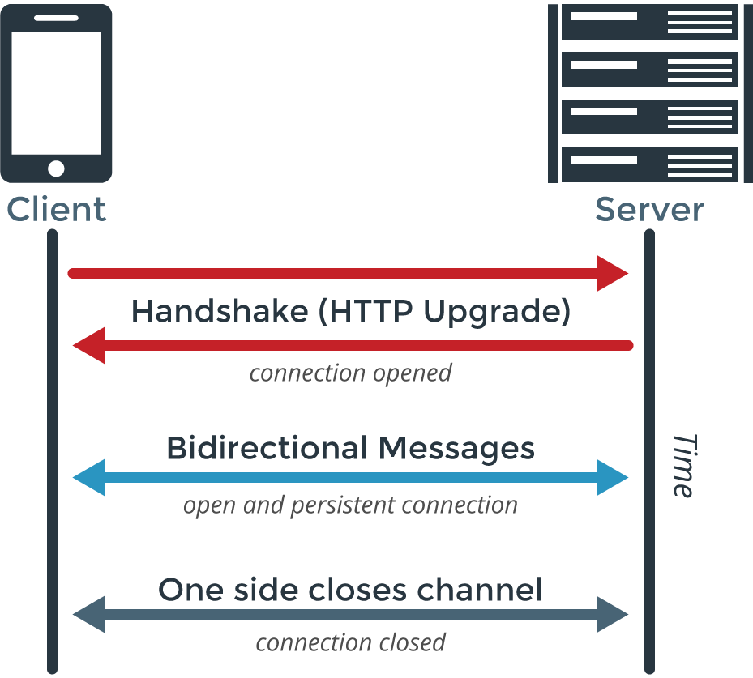
Web Sockets

Slide 88
Web Socket workflow
The client sends a get request to the web server with
header set to “Connection:upgrade”
Another header telling the server what the client wants to upgrade “Upgrade:websocket”
Sec-websocket-key:key a key that is being exchanged between client and server to make sure the communication will be secured
The server responds with a status code of 101 indicating switching of protocol to the client
The server also responds with the same “Connection:upgrade” and “Upgrade:websocket” information
The server also modifies the Sec-websocket-key:key send by the client to allow the client to verify communication
3. The client and server start to communicate over websockets

Slide 89
Using gorilla/websocket package
var addr = flag.String("addr", "localhost:8080", "http service address")
var upgrader = websocket.Upgrader{} // use default options
func echo(w http.ResponseWriter, r *http.Request) {
c, err := upgrader.Upgrade(w, r, nil)
if err != nil {
log.Print("upgrade:", err)
return
}
defer c.Close()
for {
mt, message, err := c.ReadMessage()
if err != nil {
log.Println("read:", err)
break
}
log.Printf("recv: %s", message)
err = c.WriteMessage(mt, message)
if err != nil {
log.Println("write:", err)
break
}
}
}
func home(w http.ResponseWriter, r *http.Request) {
homeTemplate.Execute(w, "ws://"+r.Host+"/echo")
}
func main() {
flag.Parse()
log.SetFlags(0)
http.HandleFunc("/echo", echo)
http.HandleFunc("/", home)
log.Fatal(http.ListenAndServe(*addr, nil))
}
Updater enables us to upgrade the connection to websocket, restrict connection from a specific origin, and define the Received and Send Buffer size (in the following example we just use the defaults)

Slide 90
Module09 - Exercise

Slide 91
Profiling go programs
The go standard library has two libraries that support profiling
net/http/pprof
runtime/pprof
Pprof is a tool for visualization and analysis of profiling data.
useful for identifying where your application is spending its time (CPU and memory)
You can install it using:
$ go get github.com/google/pprof
A Profile is a collection of stack traces showing the call sequences that led to instances of a particular event, such as allocation. Packages can create and maintain their own profiles; the most common use is for tracking resources that must be explicitly closed, such as files or network connections. – pkg/runtime/pprof

Slide 92
Profiling go programs - ReadMemoryStats
func printMemoryStats(status string){
fmt.Println(status)
runtime.ReadMemStats(&mem)
log.Println(mem.Alloc)
log.Println(mem.TotalAlloc)
log.Println(mem.HeapAlloc)
log.Println(mem.HeapSys)
}
// hugeMap allocates 100 megabytes
func hugeMap() *map[string][]byte {
s := make(map[string][]byte)
s["first"] = make([]byte, 100000000)
s["second"] = make([]byte, 100000000)
return &s
}
func main() {
var mem runtime.MemStats
printMemoryStats("start")
for i := 0; i < 10; i++ {
s := hugeMap()
if s == nil {
log.Println("oh noes")
}
}
printMemoryStats("finish")
}
We can use ReadMemoryStats from the runtime package to easily get the current stats of memory
The TotalAlloc shows the total memory that was accumulated
The heap allocation shows the amount of memory in the point in time where we call to ReadMemStats
https://golang.org/pkg/runtime/#MemStats

Slide 93
Profiling go programs - CPU
We can use the pprof tool by creating a .profile file for analysis by instrumenting our code
The only thing we need to do in order to instrument our code is calling the StartCPUProfile method of the runtime library
And finally call the StopCPUProfile
Calling StartCPUProfile will create a .profile file that we then give to the pprof to analyze
For example:
var factVal uint64 = 1
var i int = 1
var n int
func factorial(n int) uint64 {
if n < 0 {
fmt.Print("cant use Factorial of negative number“)
} else {
for i := 1; i <= n; i++ {
factVal *= uint64(i)
}
}
return factVal
}
func main() {
pprof.StartCPUProfile(os.Stdout)
defer pprof.StopCPUProfile()
for i := 0; i < 10; i++ {
factorial(10000000)
}
}
$ go build -o cpuprofiling && time ./cpuprofiling > cpu.profile
$ go tool pprof cpu.profile

Slide 94
Profiling go programs -Memory
To do memory profiling we just need to change the call from StartCPUProfile to WriteHeapProfile
Please make sure to call the WriteHeapProfile after memory has been allocated
Please note that we have only one function to call that just creates a snapshot at the given point in time, rather having two functions start and stop that suggest an ongoing process like cpu
Building and running is the same process like cpu profiling
func hugeMap() *map[string][]byte {
s := make(map[string][]byte)
s["first"] = make([]byte, 100000000)
s["second"] = make([]byte, 100000000)
return &s
}
func main() {
for i := 0; i < 10; i++ {
s := hugeMap()
if s == nil {
log.Println("oh noes")
}
}
pprof.WriteHeapProfile(os.Stdout)
}
$ go build -o memoryprofiling && time memoryprofiling > cpu.profile
$ go tool pprof cpu.profile

Slide 95
Profiling using remote http server
In order for our app to support remote profiling using an http server, we need to enable it by importing the "net/http/pprof"
We also need to pull up a webserver ,the webserver is needed cause the pprof exposes some endponts through it
If there is already a webserver in our app, and provided that we use a different ServeMultiplexer than the default, we will need to add the endoints to it, as shown in the example
Now you can access profiling information
http://localhost:5000/debug/pprof/
package main
import (
"net/http"
"net/http/pprof"
)
func myendpoint(w http.ResponseWriter, r *http.Request) {
w.Write([]byte("simple web server"))
}
func main() {
r := http.NewServeMux()
r.HandleFunc("/", myendpoint)
r.HandleFunc("/debug/pprof/", pprof.Index)
r.HandleFunc("/debug/pprof/cmdline", pprof.Cmdline)
r.HandleFunc("/debug/pprof/profile", pprof.Profile)
r.HandleFunc("/debug/pprof/symbol", pprof.Symbol)
r.HandleFunc("/debug/pprof/trace", pprof.Trace)
http.ListenAndServe(":5000", r)
}

Slide 96
What are those profiling endpoints?
Actually all the below links are just links to .profiles that in order to process we will need to use a tool lilke pprof
block: stack traces that led to blocking on synchronization primitives
goroutine: stack traces of all current goroutines
heap: a sampling of all heap allocations
mutex: stack traces of holders of contended mutexes
threadcreate: stack traces that led to the creation of new OS threads
Those are special links that are dynamically generated
profile: a 30 second cpu profile that is created dynamically and returned as a file
Trace: a 5 second trace hat is created dynamically and returned as a file
So in order to use those we will need to execute from a different shell:
go tool pprof http://localhost:6060/debug/pprof/<.profile>
Where <.profile> is the name of the subject we wish to get profiling information on for example:
go tool pprof http://localhost:6060/debug/pprof/goroutine

Slide 97
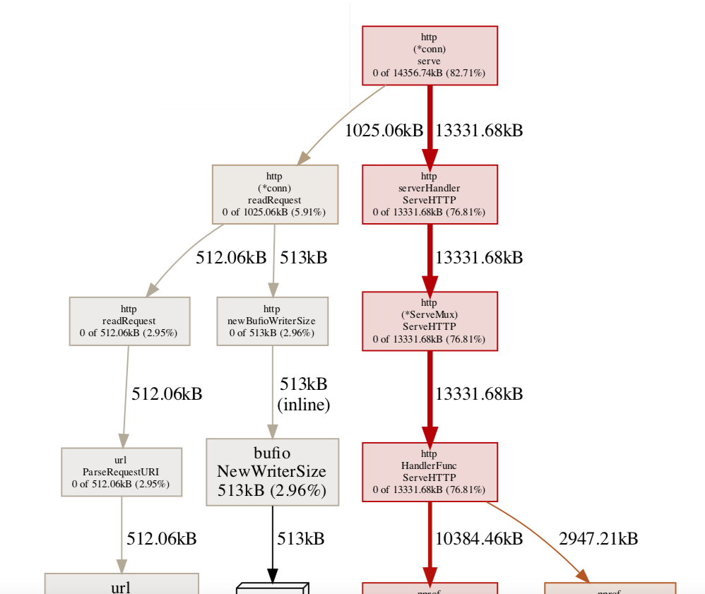
Visualizing profiling data
We can generate an image for the data that was analysed in the format of svg, pdf, png, or gif
Make sure that you have graphviz installed on your system (on mac you can use “brew install”) https://enterprise-architecture.org/downloads?id=208
Then for example execute :
go tool pprof -alloc_space -pdf http://localhost:5000/debug/pprof/heap
We can also use pprof webui tool by running
$ go tool pprof -http localhost:8080 ../cpuprofiling/cpu.profile

Slide 98
Tracing
go tool trace visualizes all the runtime events over a run of your Go program,
go tool trace is better suited at finding out what your program is doing over time, not in aggregate
Creation, start and end of goroutines
Events that block/unblock goroutines (syscalls, channels, locks)
Network I/O related events
Syscalls
Garbage collection
In order to support tracing for your webserver, you will need to add following endpoint:
r.HandleFunc("/debug/pprof/trace", pprof.Trace)
For utilising tracing in a non http app all we need to do is import "runtime/trace" and then add calls to the
trace.Start and trace.Stop
Then we need to compile our app to generate the trace data, and open it with the trace tool like so:
$ go run .
$ go tool trace trace.out

Slide 99
Module10 - Exercise

Slide 100
Building Go Plugin
Plugins allow developers to build loosely coupled modular programs
Plugins are compiled as shared object libraries that can be loaded at runtime
A Go plugin is a package compiled using the -buildmode=plugin build flag to produce a shared object (.so) library file
A plugin package must be identified as main
Exported package functions and variables become shared library symbols

Slide 101
Building Go Plugin
On the right , For example you can see that the sort plugin is just an exported function name, using it is simple as:
Opening the file using plugin package plugin.Open("./plugins/bubblesort.so")
Looking for the exported function
symbol, err := p.Lookup("Sort")
Executing the function
sortFunc, ok := symbol.(func([]int) *[]int)
sorted := sortFunc(numbers)
package main
func Sort(items []int) *[]int {
if len(items) < 2 {
return &items
}
tmp := 0
for i := 0; i < len(items); i++ {
for j := 0; j < len(items)-1; j++ {
if items[j] > items[j+1] {
tmp = items[j]
items[j] = items[j+1]
items[j+1] = tmp
}
}
}
return &items
}

Slide 102
Building Go program for multiple platform
when developing software that needs to run on multiple operating systems, it is a common practice to build your final binary for many different platforms, to maximize your program’s performance
It can be difficult when the platform you are using for development is different from the platform you want to deploy your program to
In the past building for Mac or for Windows forced you to set up build machines for those operating systems

Slide 103
GOOS & GOARCH
Go solves that issue directly in the go build tool by adding support for multiple platforms.
using the env variables and build tags you can control which operating system your binary will be built for, and also you can toggle code that will run only on a specific operating system
To see all the platforms go can compile for run $ go tool dist list
To see the current architecture you are running on run $ go env GOOS GOARCH

Slide 104
GOOS & GOARCH
the following sample use file path separator as it is platform dependent to demonstrate compiling to different platforms
When running this program, you will receive different output depending on which platform you are using
On Windows we will get a\b\c, vs on linux or Mac we will get a/b/c
when calling filepath.Join() :
the Go tool chain automatically detects your machine’s GOOS and GOARCH and uses this information to use the code snippet with the right build tags and file separator
package main
import (
"fmt"
"path/filepath"
)
func main() {
s := filepath.Join("a", "b", "c")
fmt.Println(s)
}

Slide 105
GOOS & GOARCH
Note that the path.go file is with the path separator for linux based os, and we prevent this compiling on windows by adding inversion sign For !windows : path.go
path.go
main.go
// +build !windows
package main
const PathSeparator = "/"
package main
import (
"fmt"
"strings"
)
func Join(parts ...string) string {
return strings.Join(parts, PathSeparator)
}
func main() {
s := Join("a", "b", "c")
fmt.Println(s)
}
If we try to run this on windows we will get an error

Slide 106
Fixing the problem - compile on Windows
We can fix it by adding a file for windows as well: windows.go
If go finds the GOOS and GOARCH env variables it will use them for compiling; if not it will use the
current os and arch the app is running on
We can change the compilation target by changing env variables
For example: GOOS=windows go build
You will see now an app.exe file in your directory although you are on Mac or linux
// +build windows
package main
const PathSeparator = "\\"

Slide 107
Using GOOS and GOARCH Filename Suffixes
the Go standard library makes heavy use of build tags to simplify code by separating out different platform implementations into different files
Go also use suffixes for which platform the file was meant for; for example, on the os/path_windows.go is meant for windows
When naming a .go file, you can add GOOS and GOARCH as suffixes to the file’s name in that order, separating the values by underscores (_)
For example for a windows os with arm architecture we could use a file name like myfile_windows_arm64.go

Slide 108
Building Docker image for go - CGO_ENABLED=0
Usually compiled go binaries do not have any c dependencies so we are not dependent on runtime libraries, and the go libraries we use are embedded in executable
If we compile our app on linux the resulting binary will link against a few c standard libraries,this creates a dependency between our go app and the linux os
Please note that if we compile on Windows or Mac with the GOOS=linux env, we will not have this issue as the code links statically
On linux we can force the code to use static linking by using the CGO_ENABLED=0

Slide 109
Building Docker image for go
ARG TARGETOS
ARG TARGETARCH
FROM golang:1.14.3-alpine AS build
WORKDIR /src
ENV CGO_ENABLED=0
COPY . .
RUN go mod download
RUN GOOS=${TARGETOS} GOARCH=${TARGETARCH} go build -o /out/example .
FROM scratch AS bin-unix
COPY --from=build /out/example /
FROM bin-unix AS bin-linux
FROM bin-unix AS bin-darwin
FROM scratch AS bin-windows
COPY --from=build /out/example /example.exe
FROM bin-${TARGETOS} as bin
ENTRYPOINT ["/example"]
The following docker file is a generic docker file that takes TARGETOS and TARGETARCH as args
The CGO_ENABLED=0 forces go to compile with static linking, so it is not dependent on the libraries on the hosting os
Also GOOS and GOARCH are assigned with values to define the os and arch when building the app
We can build image with the following command
$ docker build -t dynamicgo --build-arg TARGETOS=windows --build-arg TARGETARCH=amd64 --target bin .
The Scratch image is a special image directly built into the docker engine which allows us to build a minimal image

Slide 110
Kubernetes Recap
Kubernetes Authomates and monitors the lifecycle of a stateless application
It can scale the app up or down and always make sure it keeps running
Kubernetes Cluster Consists of computers called nodes
The basic unit of work in kubernetes is called a pod, which is a group of one or more linux containers
Kubernetes can be divided into planes
Control plane - the actual pods that the kubernetes core components runs on, exposing the api, etc...
Data Plane - everything else meaning the nodes and pods which the application runs on

Slide 111
Kubernetes - Architecture
Kubernetes is made from one or more masters and a bunch of nodes (use to be called minions)
Master Components holds a “control plane” which is in charge of which work to run on which node
(In short, control plane is what monitors the cluster, schedules the work, makes the changes, etc..)
The nodes are what actually do the real work, they report back to the master and watch for changes

Slide 112
Kubernetes control plane and data plane
Kubernetes is actually a collection of pods implementing the k8s api and the cluster orchestration logic also referred to as the kubernetes control plane
The application/data plane is everything else meaning all the nodes that hosts all the pods that the application runs on
The controllers of the control plane implement control loops that repeatedly compare the desired state of the cluster to its actual state
When the state of the cluster changes, controllers take actions to match it back again to it’s desired state

Slide 113
Master in more detail
The Master is composed of multiple components
for simplicity, set up scripts typically start all master components on the same machine, and do not run user containers on this machine.
Kube-apiserver which is the front facing interface into the master exposes its interface via Rest api and consumes json or yaml
Etcd is the cluster store – an open source distributed key value database used to keep the state and config for the cluster
Just to make it clear, we send a manifest file that defines our intents to the api server the api server validates it and save it into the cluster store

Slide 114
Master in more detail
kube-scheduler
Component on the master that watches newly created pods that have no node assigned, and selects a node for them to run on
Factors taken into account for scheduling decisions include individual and collective resource requirements, hardware/software/policy constraints, affinity and anti-affinity specifications, data locality, inter-workload interference and deadlines
Kube-Controller-Manager - Component on the master that runs controllers
Node Controller: Responsible for noticing and responding when nodes go down
Replication Controller: Responsible for maintaining the correct number of pods for every replication controller object in the system
Endpoints Controller: Populates the Endpoints object (that is, joins Services & Pods)
Service Account & Token Controllers: Create default accounts and API access tokens for new namespaces

Slide 115

Master
Node
Cluster store
POD
POD
Kube
Scheduler
Kube
Controller
Node
POD
POD
Api Server
Run commands
kubectl

Slide 116
Kubernetes Main Concepts - Declarative and Desired State
Kubernetes supports a declarative model – hence we send the api a yaml file in a declarative form
By Desired state it means, we specify in the yaml file our desired state and the cluster takes responsibility to make sure it will happen
We describe the desired state using yaml or json file that serves as a record of intent, but we do not specify how to get there (this is kubernetes responsibility to get us there)
Things could change or go wrong over the lifetime of the cluster (node failing etc…) ,the kubernetes is responsible to always make sure that the desired state is kept intact
The kubernetes control plane controllers are always running in a loop and checking that the actual state of the cluster matches the desired state, so that if any error occurs they kick in and rectify the cluster

Slide 117
Reconciling state
Watch for the spec fields in the YAML files later!
The spec describes how we want the thing to be
Kubernetes will reconcile the current state with the spec
(technically, this is done by a number of controllers)
When we want to change some resource, we update the spec
Kubernetes will then converge that resource

Slide 118
Kubernetes basic execution unit -> Pod
A Pod is the basic execution and scaling unit in kubernetes
kubernetes runs containers but always inside pods
It is like a sandbox to run containers in
A pod is a group of containers:
running together (on the same node)
sharing resources (RAM, CPU; but also network, volumes)
A Pod models an application-specific “logical host”

Slide 119
Pod state
Pods are considered to be relatively ephemeral (rather than durable) entities
Pods do not hold state, so if a pod crashes, kubernetes will replace it with another
Multiple instances of the same pod are called replicas

Slide 120
Deployments
A Deployment controller provides declarative updates for Pods and ReplicaSets
The Deployment Object gives us a better way of handling the scaling of PODs
The advantage of using Deployment versus using a replicaset is having rolling updates support for the POD container versions out-of-the-box
Every time the application code changes, a new version of the application container is built, and then there is a need to update the Deployment manifest with the new version and tell K8s to apply the changes
K8s will then handle the rolling-out of this newer version, it will start terminating PODs with the old version as it spins up the new PODs with the updated container
This means that at some point we will have multiple versions of the same application running at the same time

Slide 121
K8S – General Demo

Slide 122
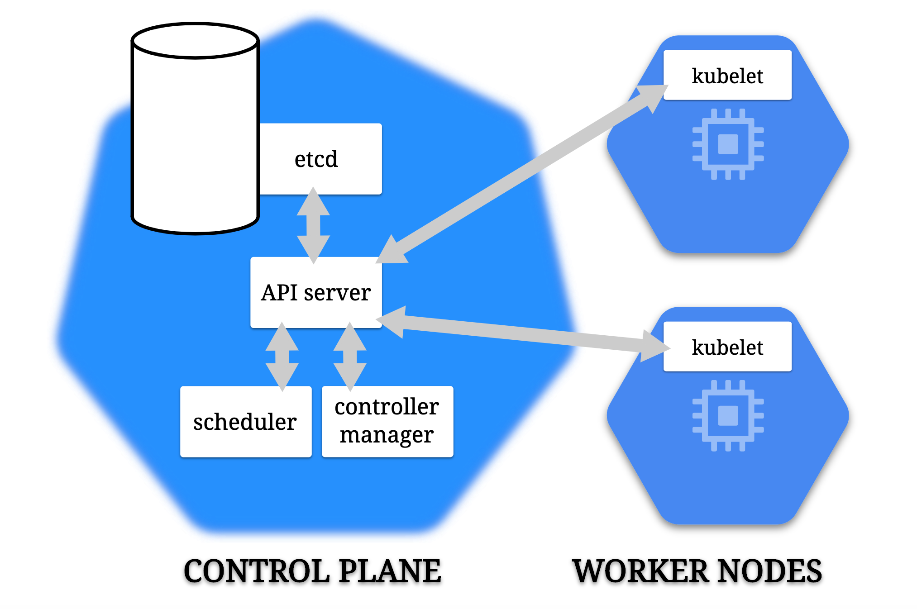

Slide 123
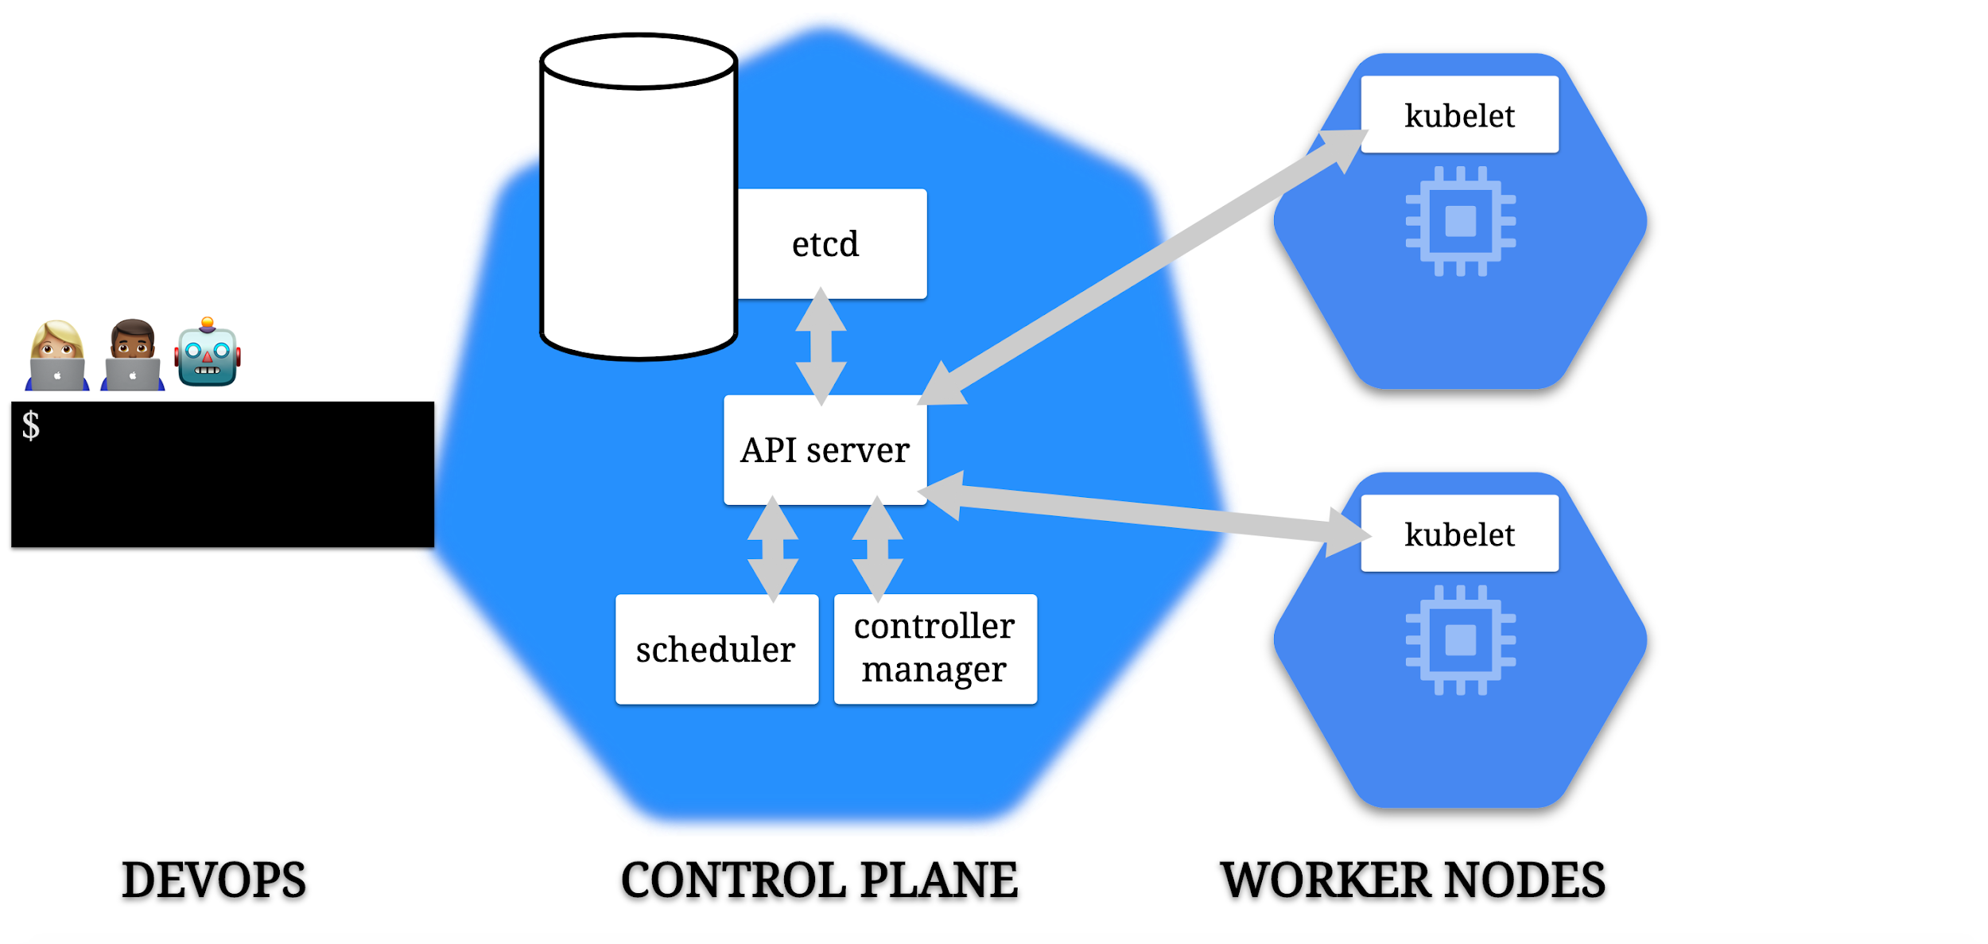

Slide 124
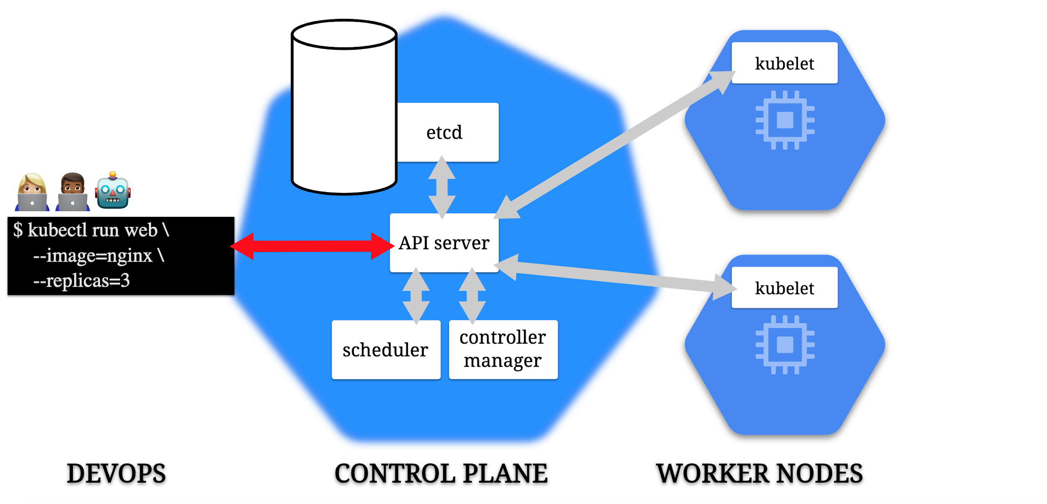

Slide 125
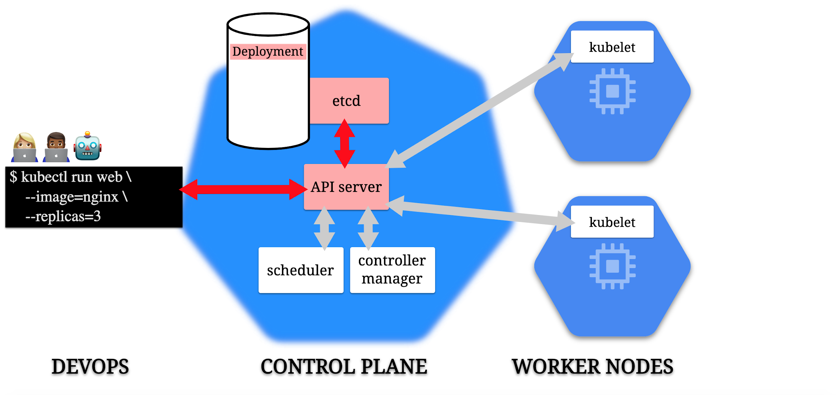

Slide 126
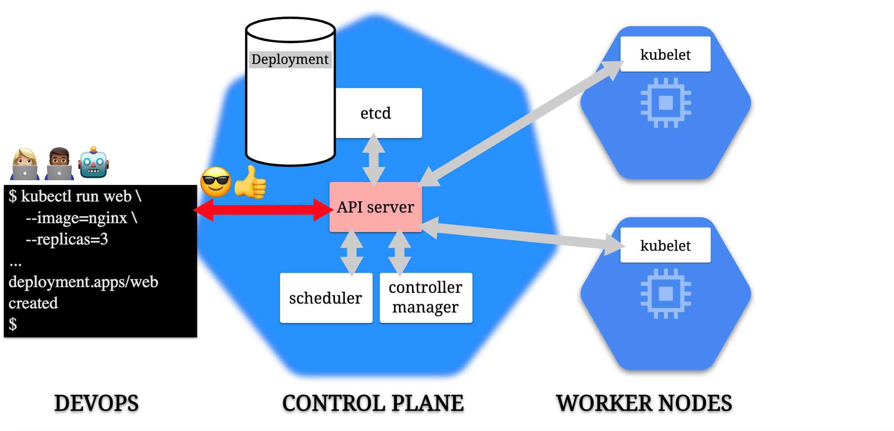

Slide 127
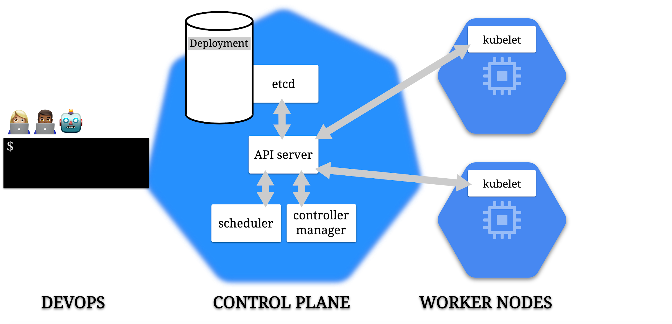

Slide 128
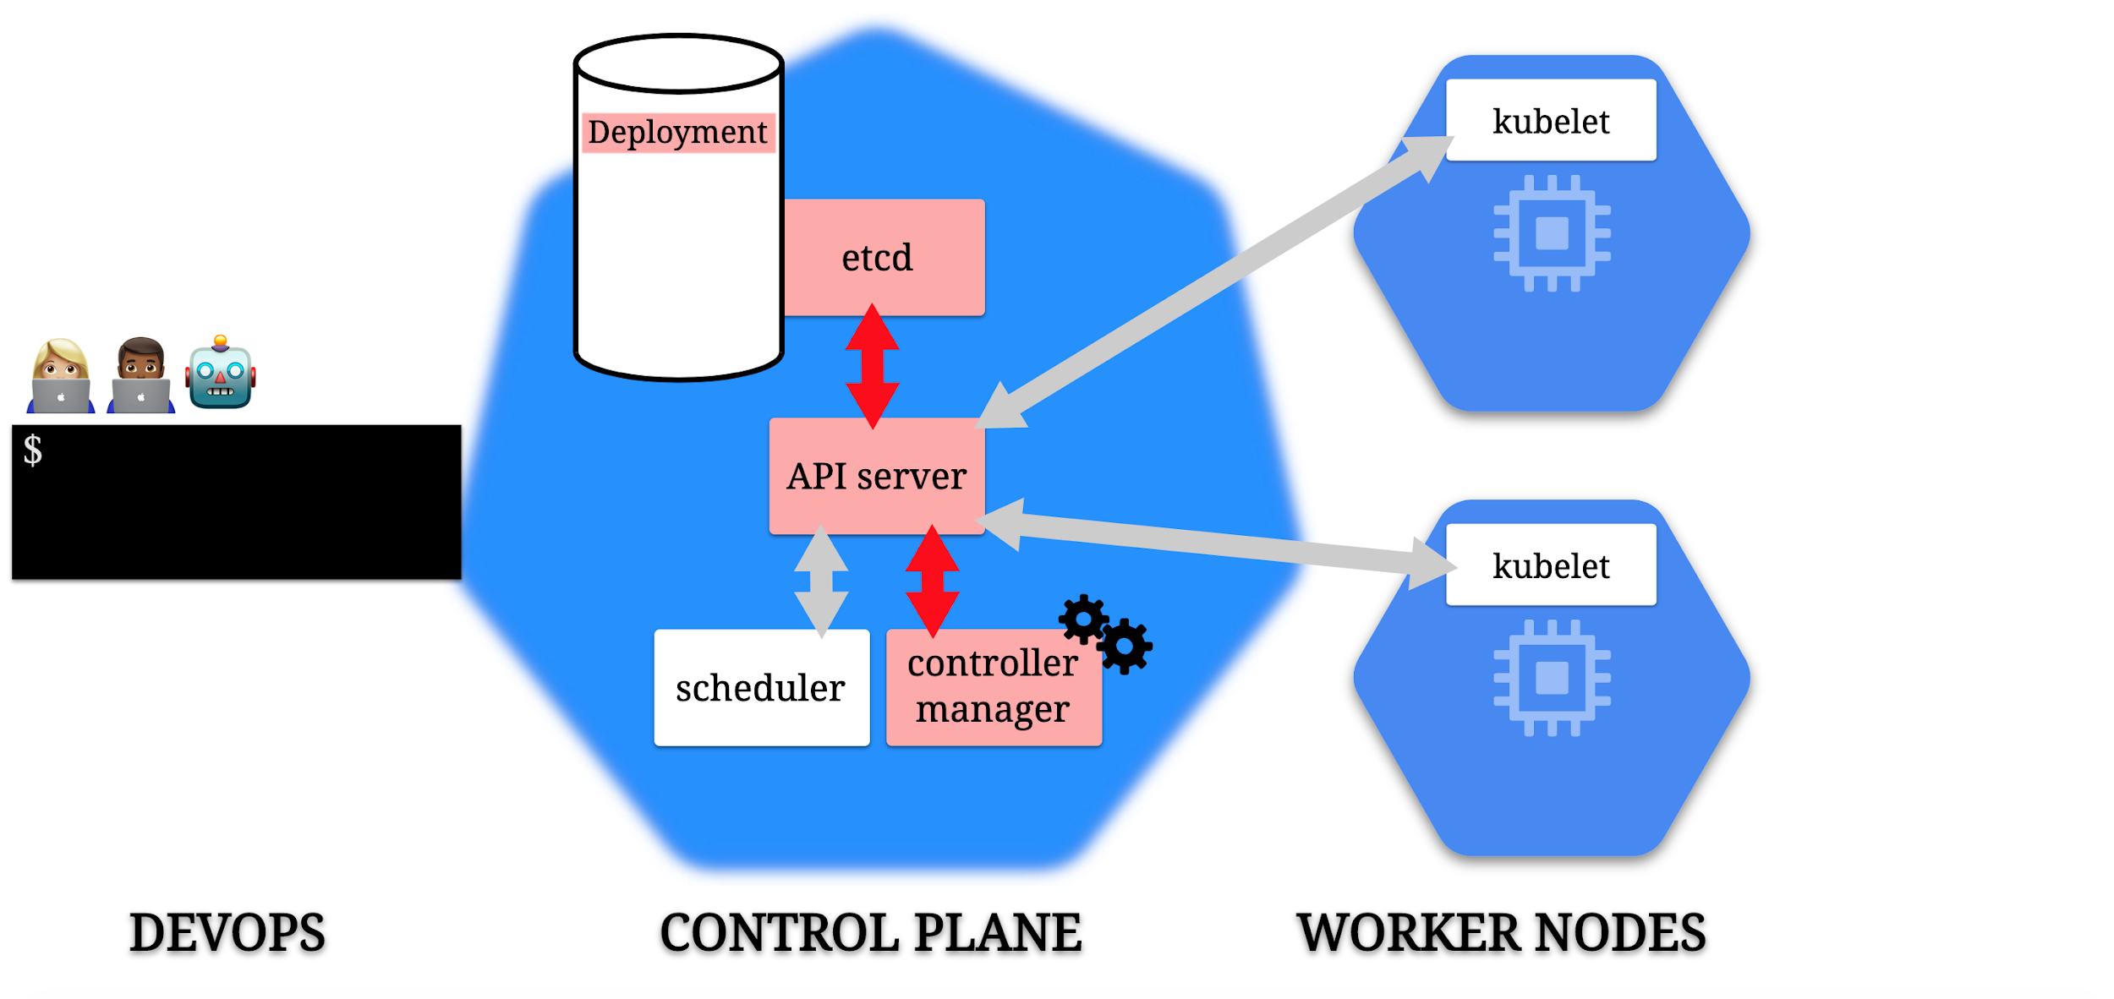

Slide 129
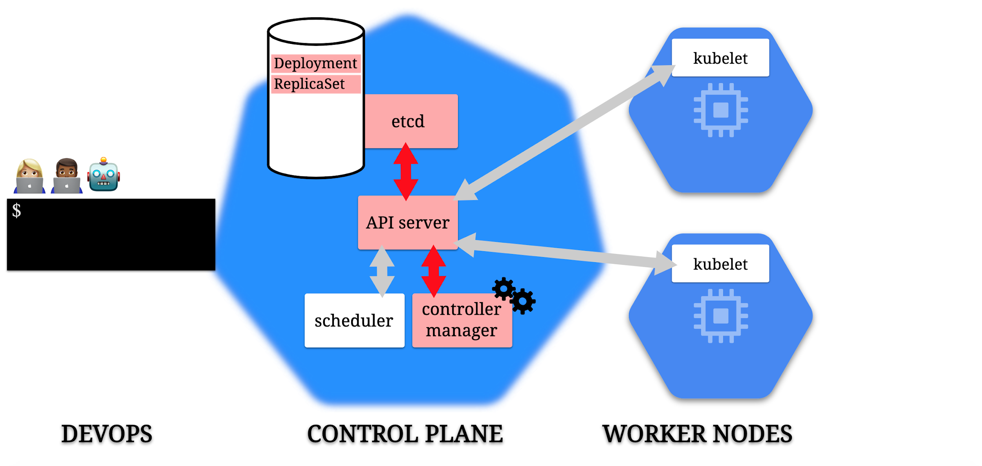

Slide 130
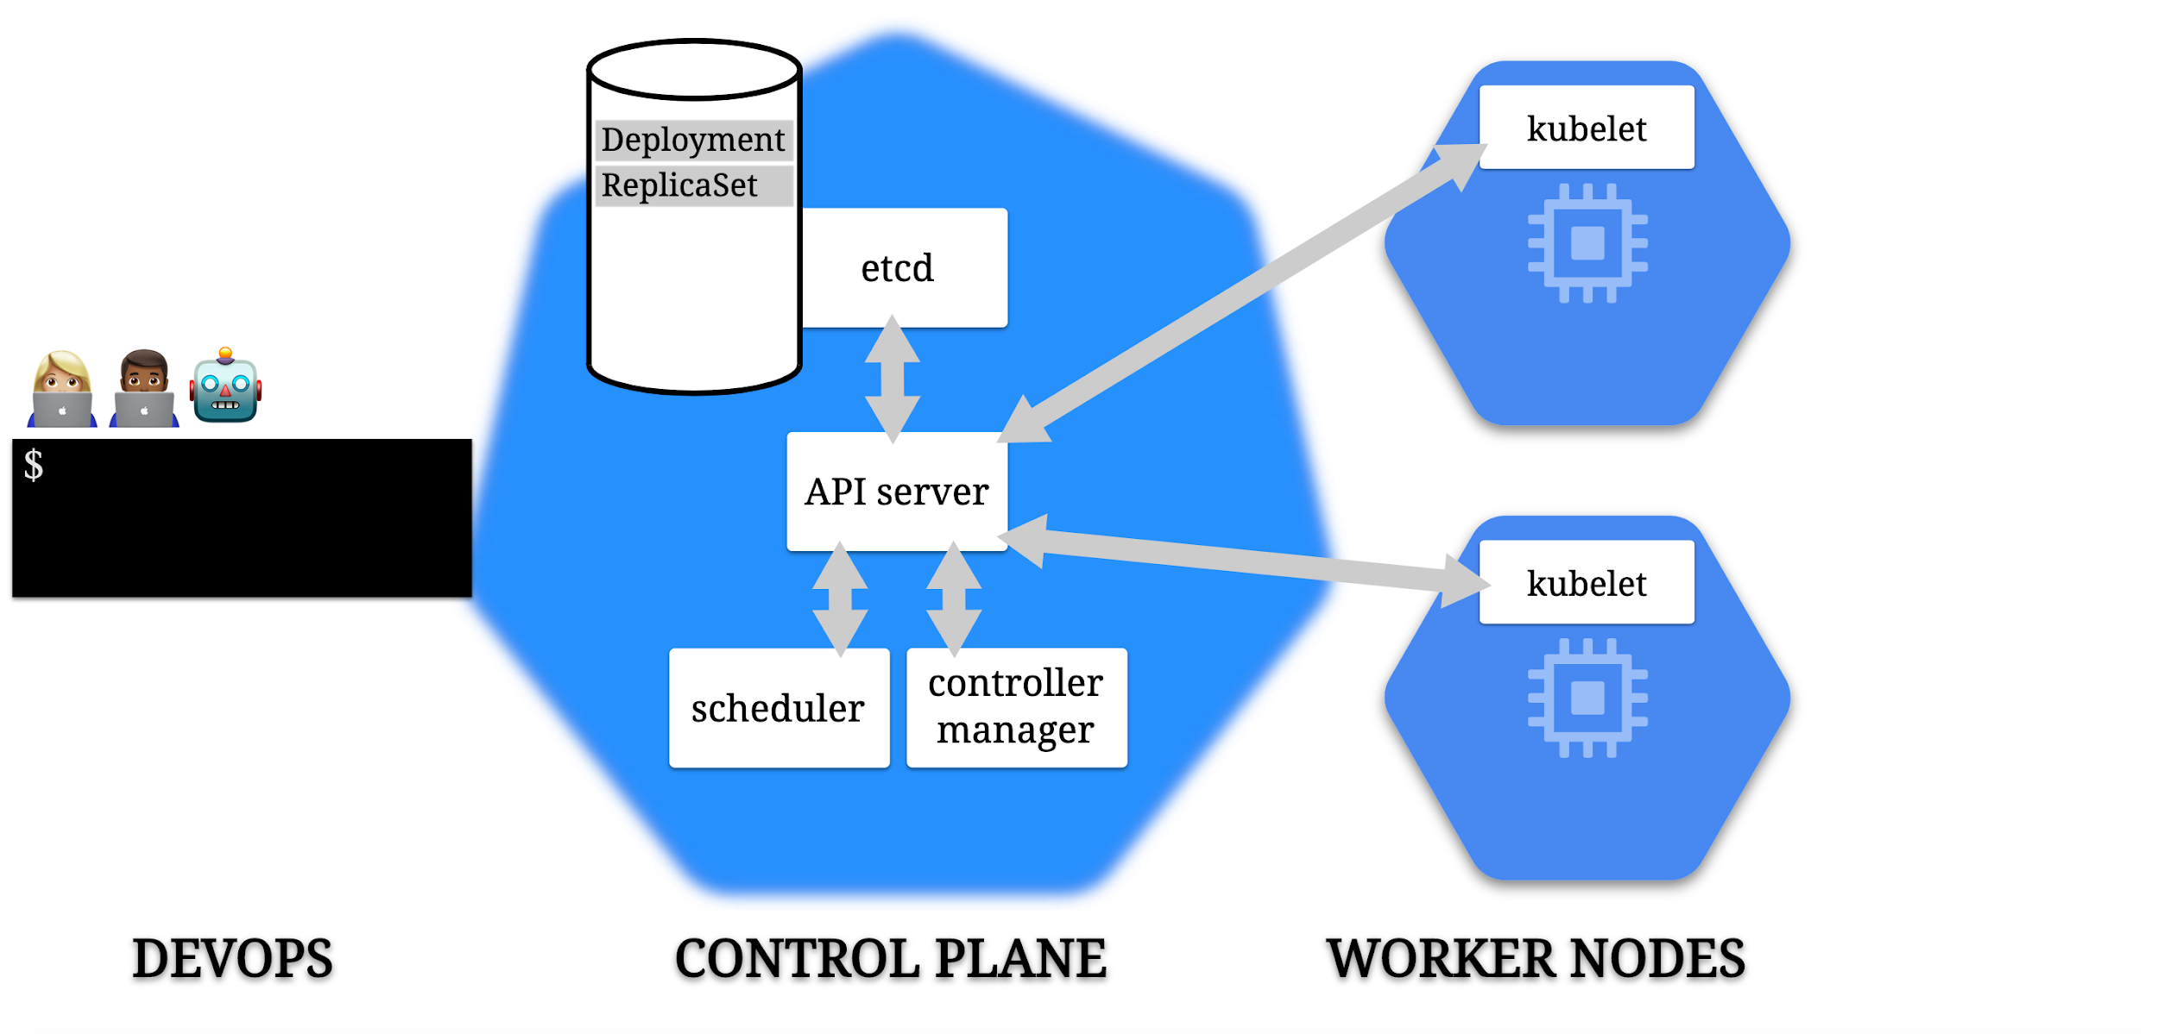

Slide 131
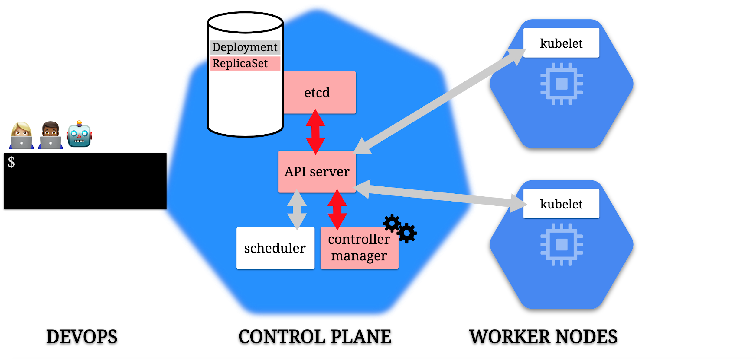

Slide 132
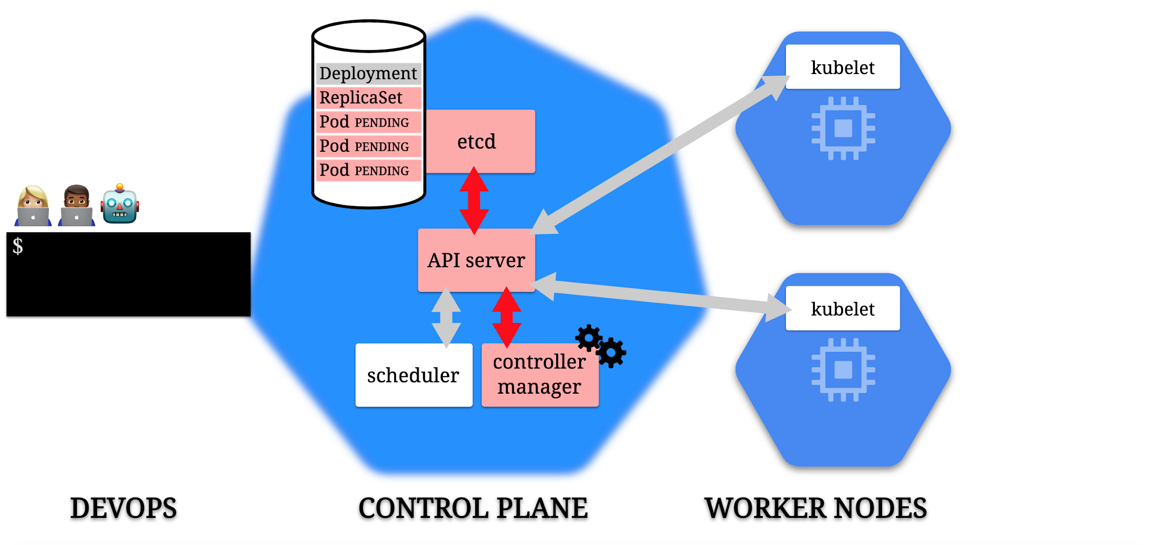

Slide 133
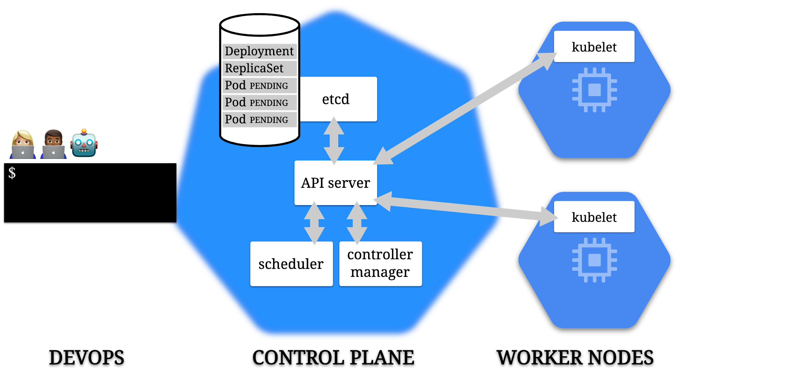

Slide 134
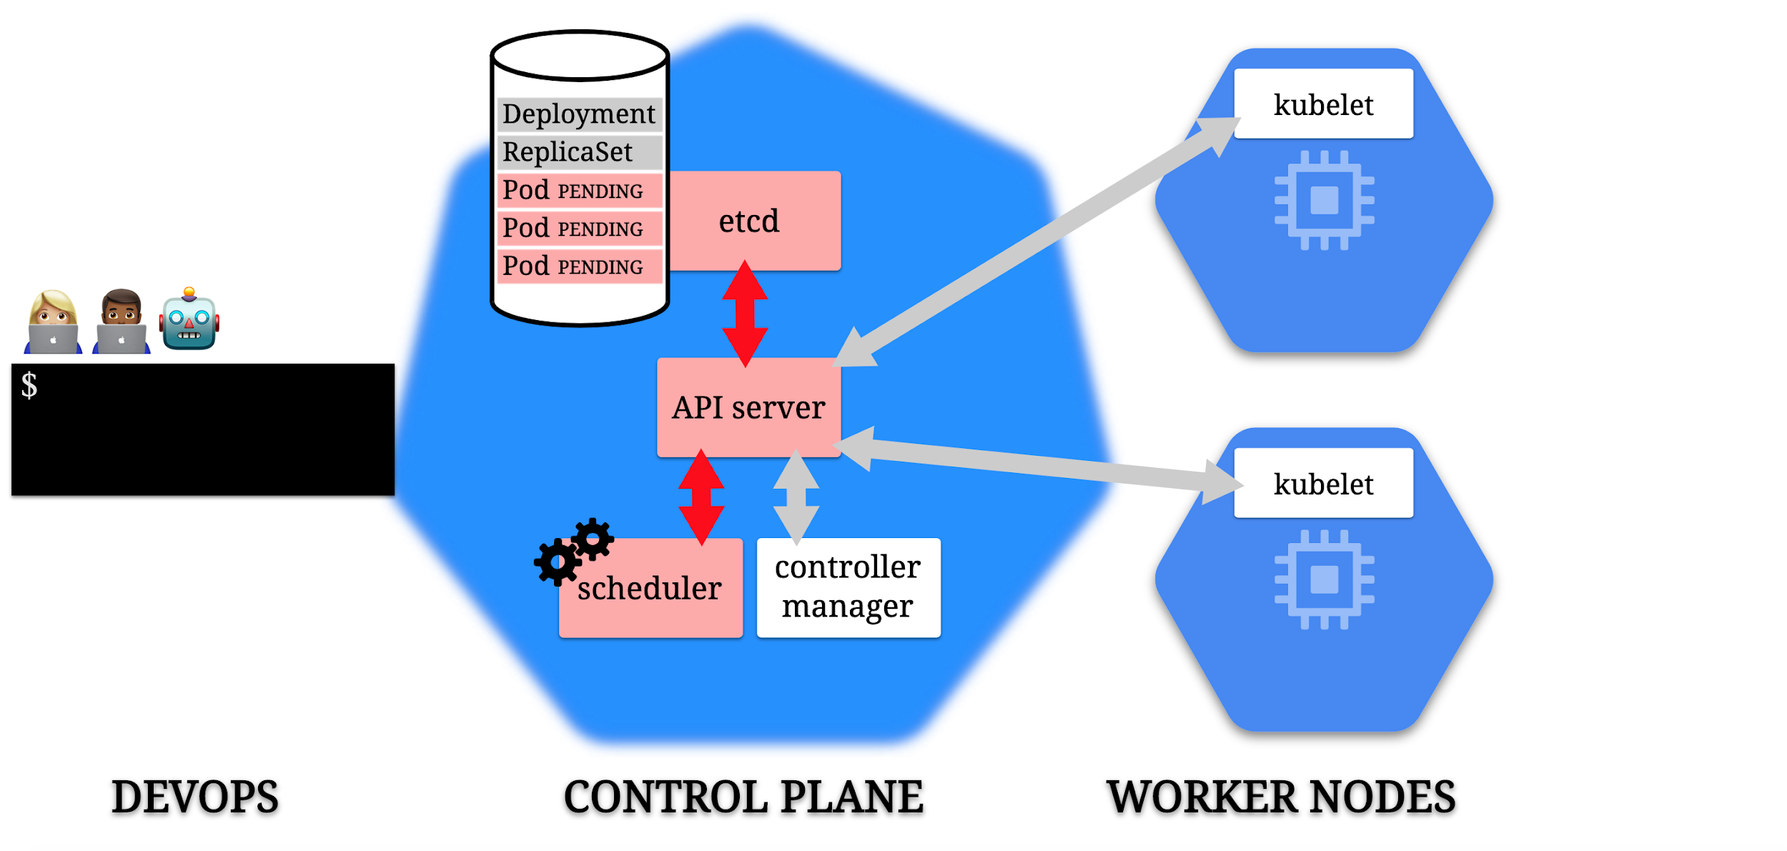

Slide 135
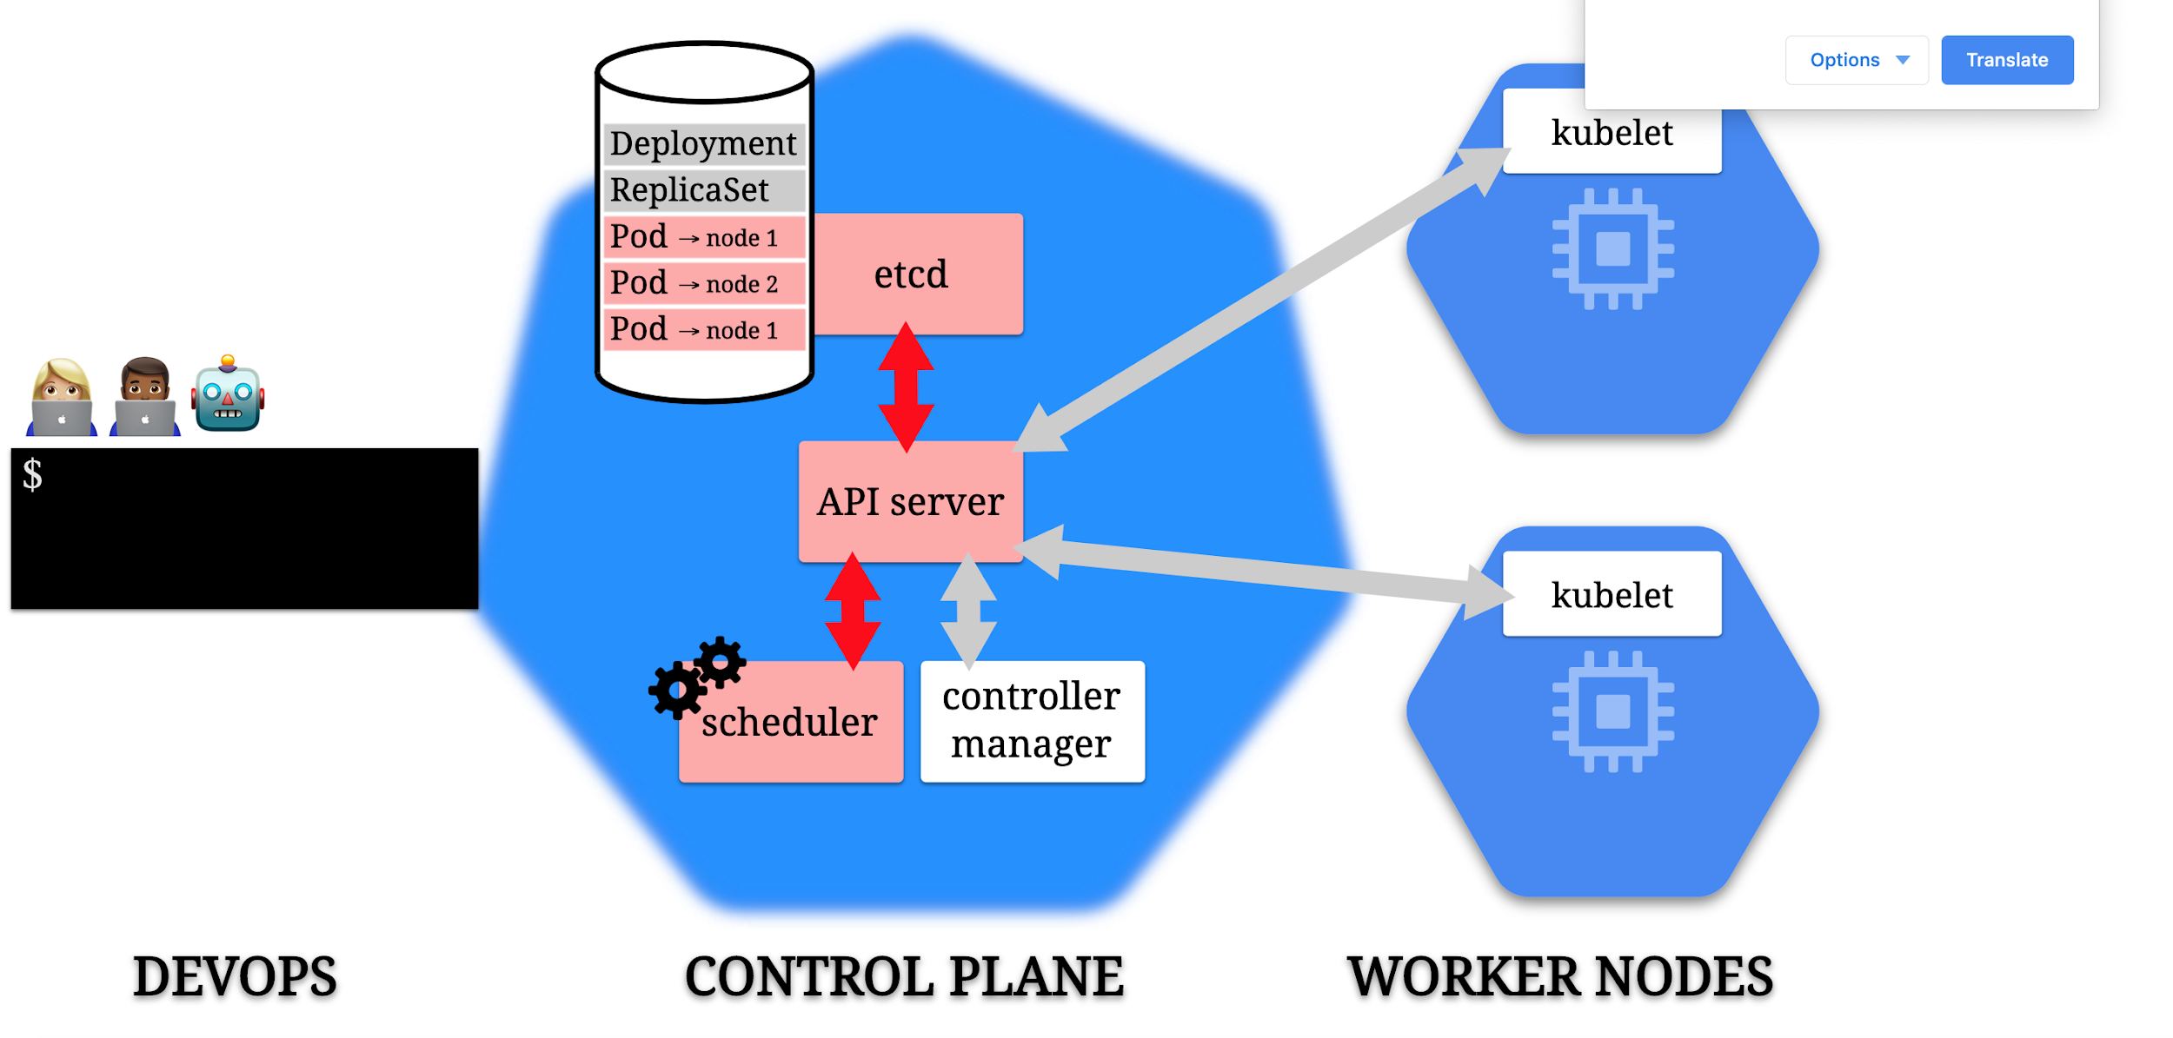

Slide 136
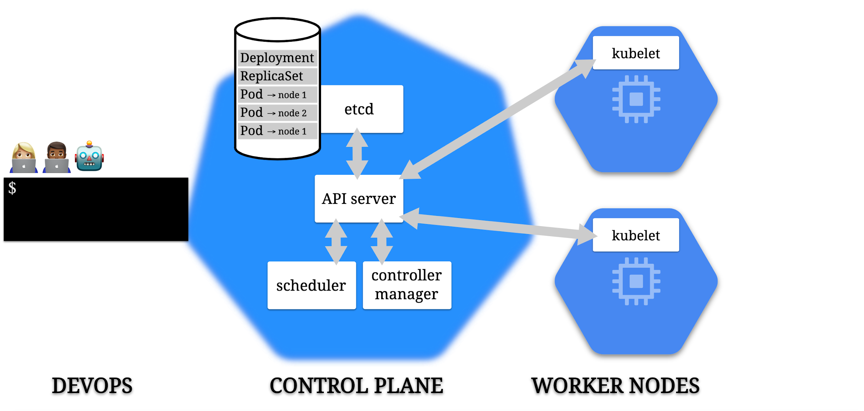

Slide 137
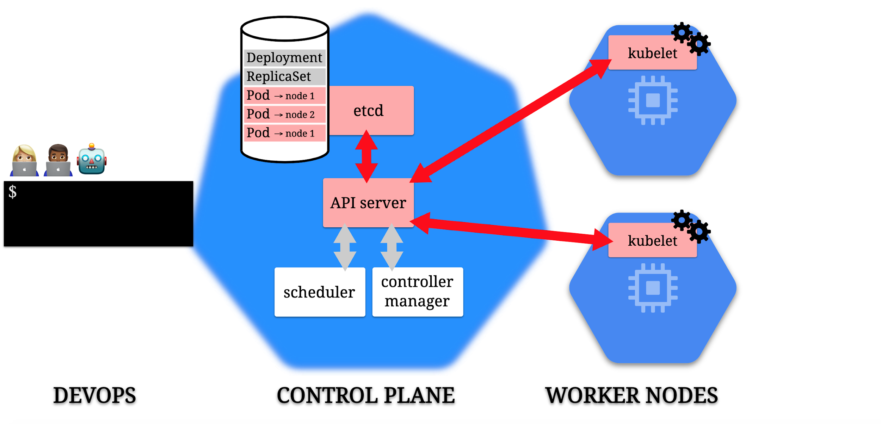

Slide 138
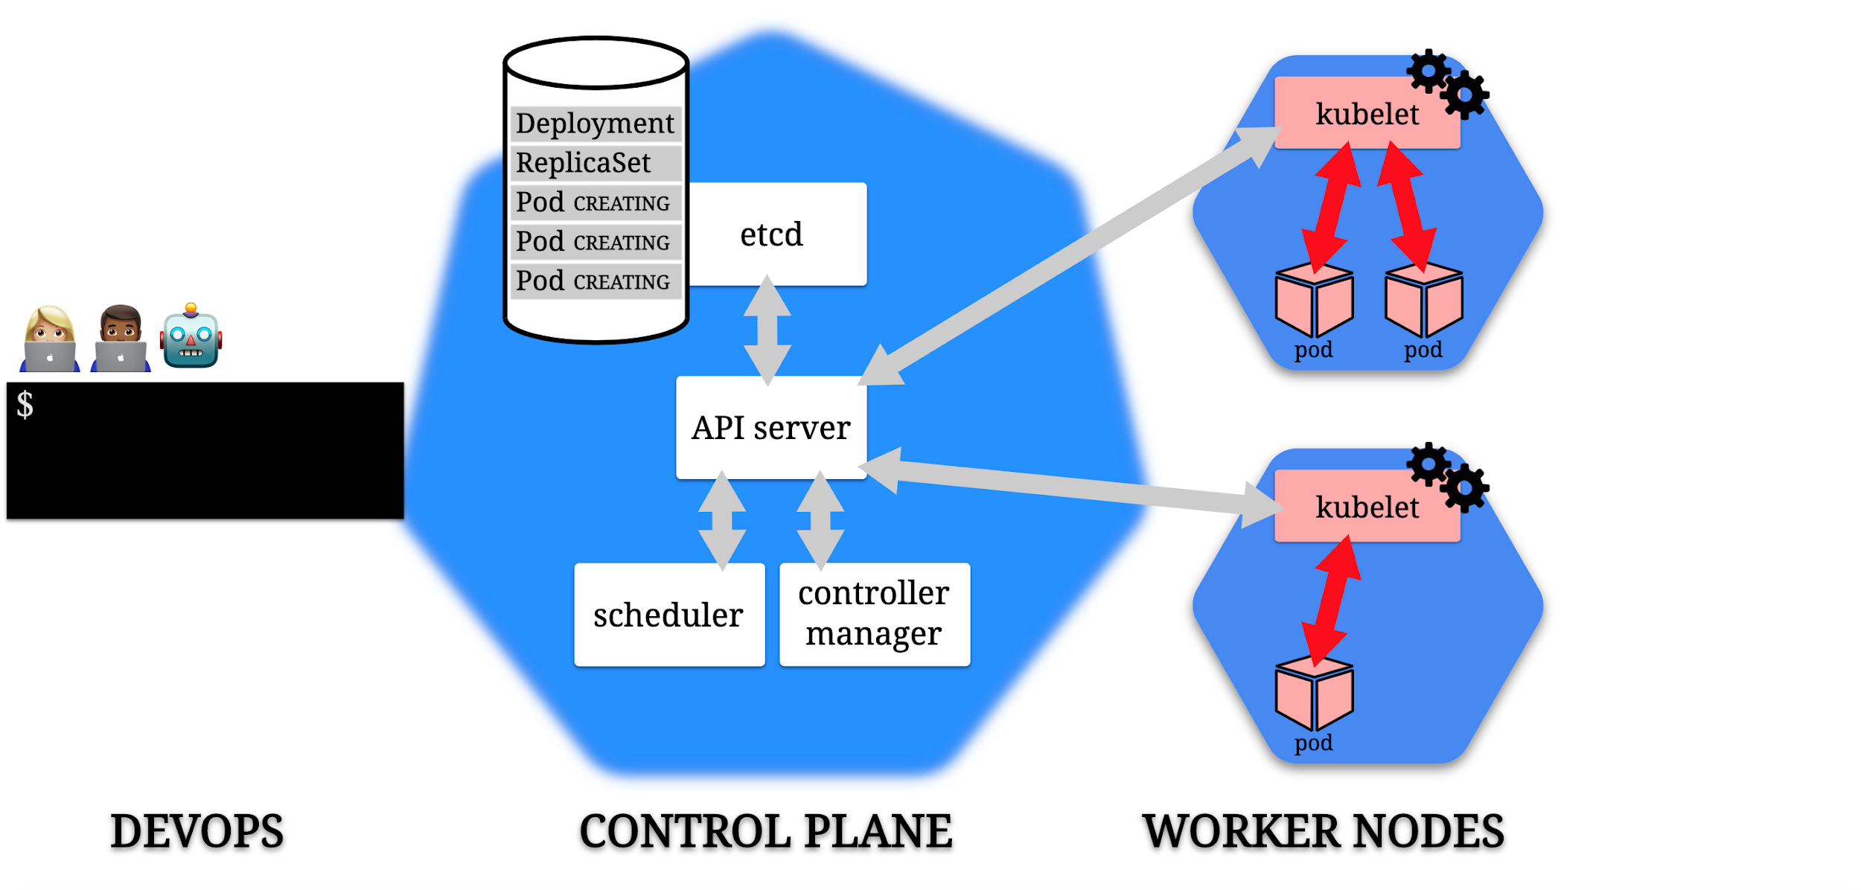

Slide 139
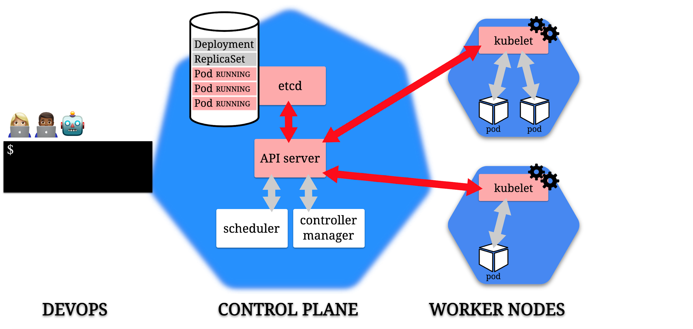

Slide 140
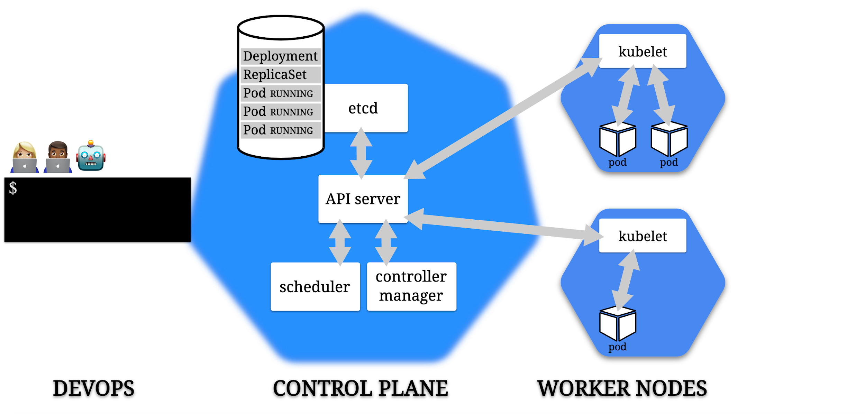

Slide 141
Module11 - Exercise

Slide 142
Kubernetes Operators
An Operator builds on Kubernetes abstractions to automate the entire lifecycle of the software it manages
As a Software developer we can say that Operators provides the infrastructure services to dependent app
Operators provide a clean and consistent way to distribute software on kubernetes clusters
Operators Extends the Kubernetes control plane and api, adding an endpoint to the kubernetes api with a custom resource
The control plane monitors and maintain the custom resource of the operator
automating systems administration by writing software to run your software

Slide 143
Kubernetes operators
An Operator is a way to package, run, and maintain a Kubernetes application
An operator is not just a regular app deployed into kubernetes – it uses all the kubernetes facilities as it is a part of it
Operators are like core services that applications running on kubernetes depend on
Deploying applications to kubernetes is made easy and consistent with operators
Operators reduce support burdens by identifying and correcting application problems automatically

Slide 144
Kubernetes operators
Operators are there to make sure that the cluster desired state is maintained
Operator can sometimes be considered a control plane component
Most Applications have state like configuration data, startup component, and data storage, and actually have their own notion of what a cluster means
Kubernetes cannot know about every stateful, complex, clustered application while also remaining general and simple
An operator knows about the internal state of the application it manages

Slide 145
Kubernetes operators
Operators are like an expert administrator
For example, an Operator can manage a cluster of database servers
It knows the details of configuring and managing its application, and it can install a database cluster of a declared software version and number of members
An Operator continues to monitor its application as it runs, and can back up data, recover from failures, and upgrade the application over time, automatically
Cluster users employ kubectl and other standard tools to work with Operators and the applications they manage

Slide 146
Kubernetes operators
Operators enables us to provide specific features for our software by extending kubernetes
Operators are like the foundation services that remove the management overhead from administrators
Deploying applications with an operator to manage it makes life easier in the matter of management and maintenance
A lot of companies already adopted operators, you can check out Operatorhub.io

Slide 147
What Operators are made of
Operator Extends the kubernetes control plane and api by creating new CR’s
A CR is short for a custom resource and it is a structured data provided to the operator controler to watch
CRD (custom resource definition) is the schema for the CR which actually is a resource that extends the k8s api
CRDs only extend the cluster on which they exist
So Simply speaking : operator adds the following:
a new endpoint to the api, called a CR (custom resource)
a control plane component that manages that resource

Slide 148
What does it mean to create an operator
creating a CRD
providing a program that runs in a loop watching CRs of that kind
response to changes in the CR in a specific way helps with application
a. Scaling
b. Upgrading
c. Managing software

Slide 149
Kubectl apply -f vitualservice.yaml
Control plane
Controller manager
Api Server
Scheduler
Istio operator
Virtual service (CR)
node
pod
pod
pod
proxy
proxy
proxy
app
app
app

Slide 150
Etcd operator example
Etcd is a lightweight distributed key value store database
Adding new etcd member to the cluster is not as trivial as just running a pod
To manage etcd requires signifiant knowledge of an admin; for example,
how to join a new node to the cluster, backup and configuration, and upgrade
The etcd operator holds that complexity
If one of an etcd member in the cluster fails, reconciliation is triggered, and the operator heals the cluster
The etcd operator will have to take into account how to rejoin a member, whether it is a master or slave etc...

Slide 151
Etcd operator exercise
Ecd It is the underlying data store at the core of Kubernetes, and a key piece of several distributed applications
you’ll deploy the etcd Operator
then have it create an etcd cluster according to your specifications.
have the Operator recover from failures
perform a version upgrade while the etcd API continues to service read and writes
Notes:
kind create cluster --config kind.yaml

Slide 152
CR’s
CR’s are acting like a native k8s resource,
You define a CRD and k8s is responsible to expose it for you through the api
Using the api you can read and set data on your cusom resource
Usually you will interact with k8s api via kubectl
Kubernetes use CR’s as a mechanism to expose new api objects
When defining CRD for the CR’s you must follow the regular k8s conventions using .spec and .status etc…
The CR’s are being continually monitored by the operator custom controller that in turn can also create other api objects and more components to support its operation
Notes:
kind create cluster --config kind.yaml

Slide 153
operator scope
Kubernetes support namespaces in which only one resource name of a specific type can exist
You can restrict your operator for a namespace to allow separate teams to create instances of it, upgrade and test each of the instances without affecting the others
There are other situations that you can create operators with a cluster scope to control the entire cluster (istio is a good example)
Operators like any other k8s resources follows the RBAC rules they are assigned with, and whether they are namespace scoped or cluster scoped they need to have the right Role assigned (Role or ClusterRole)
Notes:
kind create cluster --config kind.yaml

Slide 154
operator sdk
There is a lot of complexity and boilerplate code involved in creating an operator
Operator-sdk is a framework that allows us to easily create an operator in golang, and distribute our app, by automating almost everything
There are other good ways to get started with developing an operator, kubebuilder is one of them
The sdk use controller-runtime k8s libraries which are a set of libraries supporting creation of k8s controller

Slide 155
Why operator sdk
operator-sdk provides us an additional important feature which is the OLM
the sdk adds OLM integration points in the code
It also has support for creating operators using helm or ansible
Support for metering

Slide 156
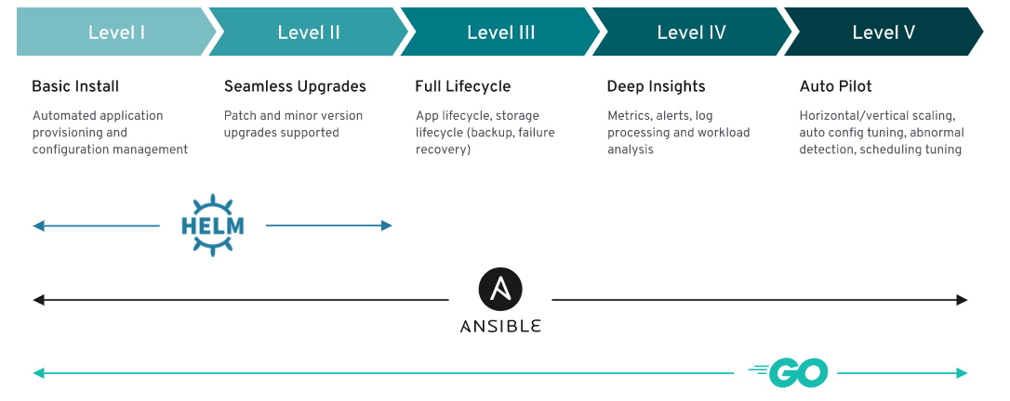
maturity model
Notes:
kind create cluster --config kind.yaml

Slide 157
Steps for building our operator
Create the CRD’s as the model for our app, that also provides the api to interact with
Create the controller - each CRD needs to have one controller that watches it for changes, and handles them accordingly
Build the Operator image and create the Kubernetes manifest to deploy the Operator and its RBAC components (service accounts, roles, etc.)

Slide 158
operator sdk installation
Download from https://github.com/operator-framework/operator-sdk/releases
Install :
$ wget https://github.com/operator-framework/operator-sdk/releases/download/v0.../...
$ sudo mv operator-sdk-v... /usr/local/bin/operator-sdk
$ sudo chmod +x /usr/local/bin/operator-sdk
Notes:
Sometimes you could have a problem compiling using the operator sdk
it is caused because of an error in your local env. You need to set the go env GOROOT.
Run export GOROOT=$(go env GOROOT)

Slide 159
bootstrap the operator
$ operator-sdk new gameserver --repo github.com/motiso/gameserver
//Point the repo argument to the repository you want to use for your Go module.
INFO[0000] Creating new Go operator 'gameserver'.
INFO[0000] Created go.mod
INFO[0000] Created tools.go
INFO[0000] Created cmd/manager/main.go
INFO[0000] Created build/Dockerfile
INFO[0000] Created build/bin/entrypoint
INFO[0000] Created build/bin/user_setup
INFO[0000] Created deploy/service_account.yaml
INFO[0000] Created deploy/role.yaml
INFO[0000] Created deploy/role_binding.yaml
INFO[0000] Created deploy/operator.yaml
INFO[0000] Created pkg/apis/apis.go
INFO[0000] Created pkg/controller/controller.go
INFO[0000] Created version/version.go
INFO[0000] Created .gitignore
INFO[0000] Validating project
INFO[0022] Project validation successful.
INFO[0022] Project creation complete.

Slide 160
Adding new CRD’s to the operator
├── build
│ ├── Dockerfile
│ └── bin
│ ├── entrypoint
│ └── user_setup
├── cmd
│ └── manager
│ └── main.go
├── deploy
│ ├── crds
│ │ ├── gameserver.com_gameservers_crd.yaml
│ │ └── gameserver.com_v1_gameserver_cr.yaml
│ ├── operator.yaml
│ ├── role.yaml
│ ├── role_binding.yaml
│ └── service_account.yaml
├── go.mod
├── go.sum
├── pkg
│ ├── apis
│ │ ├── addtoscheme_gameserver_v1.go
│ │ ├── apis.go
│ │ └── gameserver
│ │ ├── group.go
│ │ └── v1
│ │ ├── doc.go
│ │ ├── gameserver_types.go
│ │ ├── register.go
│ │ └── zz_generated.deepcopy.go
│ └── controller
│ └── controller.go
├── tools.go
└── version
└── version.go
We can use the add api command to add new CRD’s to the operator
$ operator-sdk add api --api-version=gameserver.com/v1 --kind=Gameserver
INFO[0000] Generating api version gameserver.com/v1 for kind Gameserver.
INFO[0000] Created pkg/apis/gameserver/group.go
INFO[0001] Created pkg/apis/gameserver/v1/gameserver_types.go
INFO[0002] Created pkg/apis/addtoscheme_gameserver_v1.go
INFO[0002] Created pkg/apis/gameserver/v1/register.go
INFO[0002] Created pkg/apis/gameserver/v1/doc.go
INFO[0002] Created deploy/crds/gameserver.com_v1_gameserver_cr.yaml
INFO[0002] Running deepcopy code-generation for Custom Resource group versions: [gameserver:[v1], ]
INFO[0010] Code-generation complete.
INFO[0010] Running CRD generator.
INFO[0011] CRD generation complete.
INFO[0011] API generation complete.
INFO[0011] API generation complete
The above Command generates a lot of files that are based on the kind and api version that we gave it

Slide 161
Add the controller
When creating the controller You need to use the same api-version and kind that you used before in order to scope the controller to a specific CRD
$ operator-sdk add controller --api-version=gameserver.com/v1 --kind=Gameserver
INFO[0000] Generating controller version gameserver.com/v1 for kind Gameserver.
INFO[0000] Created pkg/controller/gameserver/gameserver_controller.go
INFO[0000] Created pkg/controller/add_gameserver.go
INFO[0000] Controller generation complete.
The most interesting file in all the newly generated files is the one marked with red which is the controller file that is associated with the specific kind
The controller is responsible for:
“reconciling” a specific resource
establishing one or more “watches”

Slide 162
Let’s watch the Watch
// Watch for changes to primary resource Gameserver
err = c.Watch(&source.Kind{Type: &gameserverv1.Gameserver{}}, &handler.EnqueueRequestForObject{})
if err != nil {
return err
}
err = c.Watch(&source.Kind{Type: &corev1.Pod{}}, &handler.EnqueueRequestForOwner{
IsController: true,
OwnerType: &gameserverv1.Gameserver{},
})
if err != nil {
return err
}

Slide 163
Reconcile
The reconcile function’s main and only purpose is to make sure that the desired state is kept, and to update the kubernetes system accordingly
Usually this function starts by retrieving the primary resource that triggered directly or indirectly (because one or more of its children changed) the reconcile request
func (r *ReconcileGameserver) Reconcile(request reconcile.Request) (reconcile.Result, error) {
reqLogger := log.WithValues("Request.Namespace", request.Namespace, "Request.Name", request.Name)
reqLogger.Info("Reconciling Gameserver")
// Fetch the Gameserver instance
instance := &gameserverv1.Gameserver{}
err := r.client.Get(context.TODO(), request.NamespacedName, instance)
if err != nil {
if errors.IsNotFound(err) {
// Request object not found, could have been deleted after reconcile request.
// Owned objects are automatically garbage collected. For additional cleanup logic use finalizers.
// Return and don't requeue
return reconcile.Result{}, nil
}
// Error reading the object - requeue the request.
return reconcile.Result{}, err
}

Slide 164
Possible return values from the Reconcile function
return reconcile.Result{}, nil
The reconcile process finished with no errors and does not require another pass through the reconcile loop
return reconcile.Result{}, err
The reconcile failed due to an error and Kubernetes should requeue it to try again
return reconcile.Result{Requeue: true}, nil
The reconcile did not encounter an error, but Kubernetes should requeue it to run for another iteration
return reconcile.Result{RequeueAfter: time.Second*5}, nil
Similar to the previous result, but this will wait for the specified amount of time before requeuing the request

Slide 165
Updating state by the controller
When we wish to update kubernetes with the updated state we use the client.Client interface to call back to k8s with the updated state
To do that we need to create the resource; for example, POD, SECRET, etc.. and then we need to instantiate that type and call back to k8s
Kubernetes GO client API defines the specifications for how to instantiate the different k8s resources
// Define a new Pod object
pod := newPodForCR(instance)
// Set Gameserver instance as the owner and controller
if err := controllerutil.SetControllerReference(instance, pod, r.scheme); err != nil {
return reconcile.Result{}, err
}
// Check if this Pod already exists
found := &corev1.Pod{}
err = r.client.Get(context.TODO(), types.NamespacedName{Name: pod.Name, Namespace: pod.Namespace}, found)
if err != nil && errors.IsNotFound(err) {
reqLogger.Info("Creating a new Pod", "Pod.Namespace", pod.Namespace, "Pod.Name", pod.Name)
err = r.client.Create(context.TODO(), pod)
if err != nil {
return reconcile.Result{}, err
}

Slide 166
Running operator locally
Deploy the Crd’s kubectl apply -f deploy/crds/*_crd.yaml
Start the operator in local mode - operator-sdk run local --namespace default
Deploy an example resource (the sdk generates an example cr) kubectl apply -f deploy/crds/*_cr.yaml
Stop a running operator using control-c

Slide 167
Module12 - Exercise

Slide 168
Thank you !

